Slide 1
Colorado POST
Academy Staff Training
June 2021

Slide 2
Agenda
Group Introductions
Benchmark System Review
Academy Benchmark Roles and Permissions
Academy Forms and Submitters
Benchmark Management System (BMS)
Academy Cadet Student Review
General Navigation
Report Processes
POST Exam
Academy Admin, Academy Director Review
General Navigation
Report Processes
For Questions and System Support

Slide 3
Academy Benchmark Roles and Permissions

Slide 4
Academy Roles and Permissions
Note: users may have more than one Benchmark role, which provide combined permissions
Benchmark Role | View Own Profile | Academy Admin Staff Profile View | Create Forms
Academy Director | Y | Y | Y
Academy Admin | Y | Y | Y
Academy Cadet Student | Y | N | Y
Benchmark Role | TMS Access | Edit Own Email | View Personal Info Section
Academy Director | N | Y | Y
Academy Admin | N | Y | Y
Academy Cadet Student | Y (POST Exam completion) | Y | Y

Slide 5
Academy Forms and Submitters
Form Name | Submitter(s)
ADA Accommodation | Academy Cadet Student | Academy Admin | Academy Director
Academy Injury | Academy Director | Academy Admin
Employment Update Request | Academy Director | Academy Admin
Form 1 – Basic Certification | Academy Cadet Student
Form 5 – Change of Name | Academy Admin | Academy Director
Form 7 – Academy Approval | Academy Director | Academy Admin
Form 11E - Enrollment Advisory | Academy Cadet Student
Certificate of Completion | Academy Director | Academy Admin
POST Exam Confidentiality | Academy Cadet Student | Academy Admin | Academy Director
POST Exam Scheduling Request | Academy Director | Academy Admin

Slide 6
Benchmark Management System (BMS) ___ Academy Cadet Student Experience

Slide 7
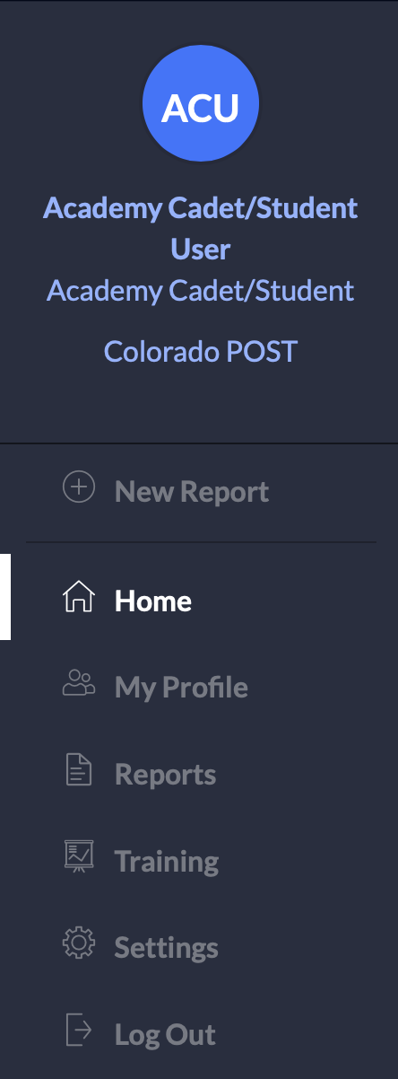
BMS General Navigation
Cadet Student Experience
Description
(+) New Report: Create a new report based on your role(s).
Home: Main landing page upon login. View and take action on Action Items and see Current Activities for reports in progress.
My Profile: Logged in user’s profile information.
Reports: Access reports in draft status; see reports that the user has submitted or reviewed.
Training: Users can access the Training Management System, where the POST Exam is administered.
Settings: Only visible to administrators and administrator functions will vary depending on assigned administrator roles.
Log Out: Will sign you out of your account.

Slide 8
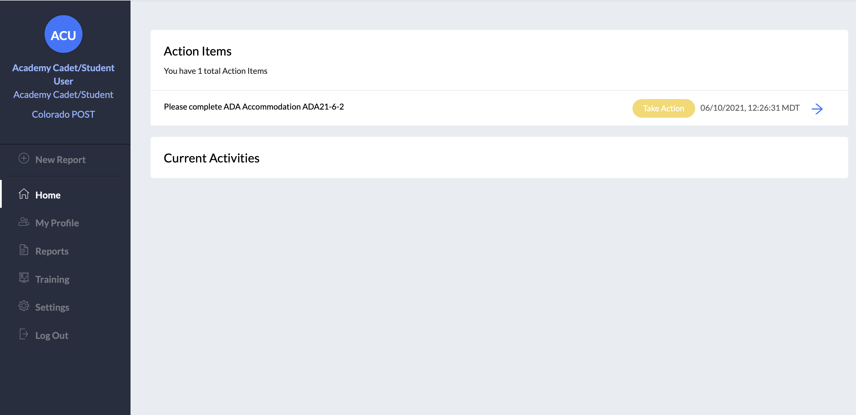
BMS General Navigation: Home
Cadet Student Experience
The Home tab navigates the user to the listing of Action Items and Current Activities, displaying the reports, requests for information, and other actions that the user needs to take.

Slide 9
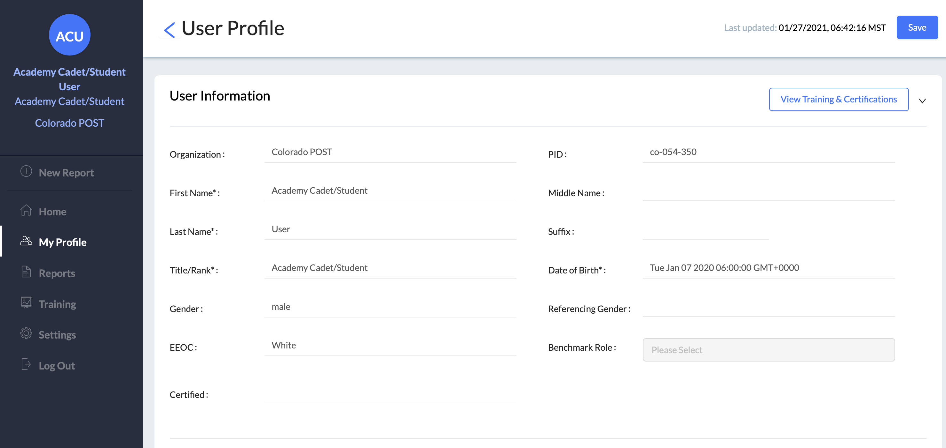
BMS General Navigation: My Profile
Cadet Student Experience
My Profile: Logged in user’s profile information.

Slide 10
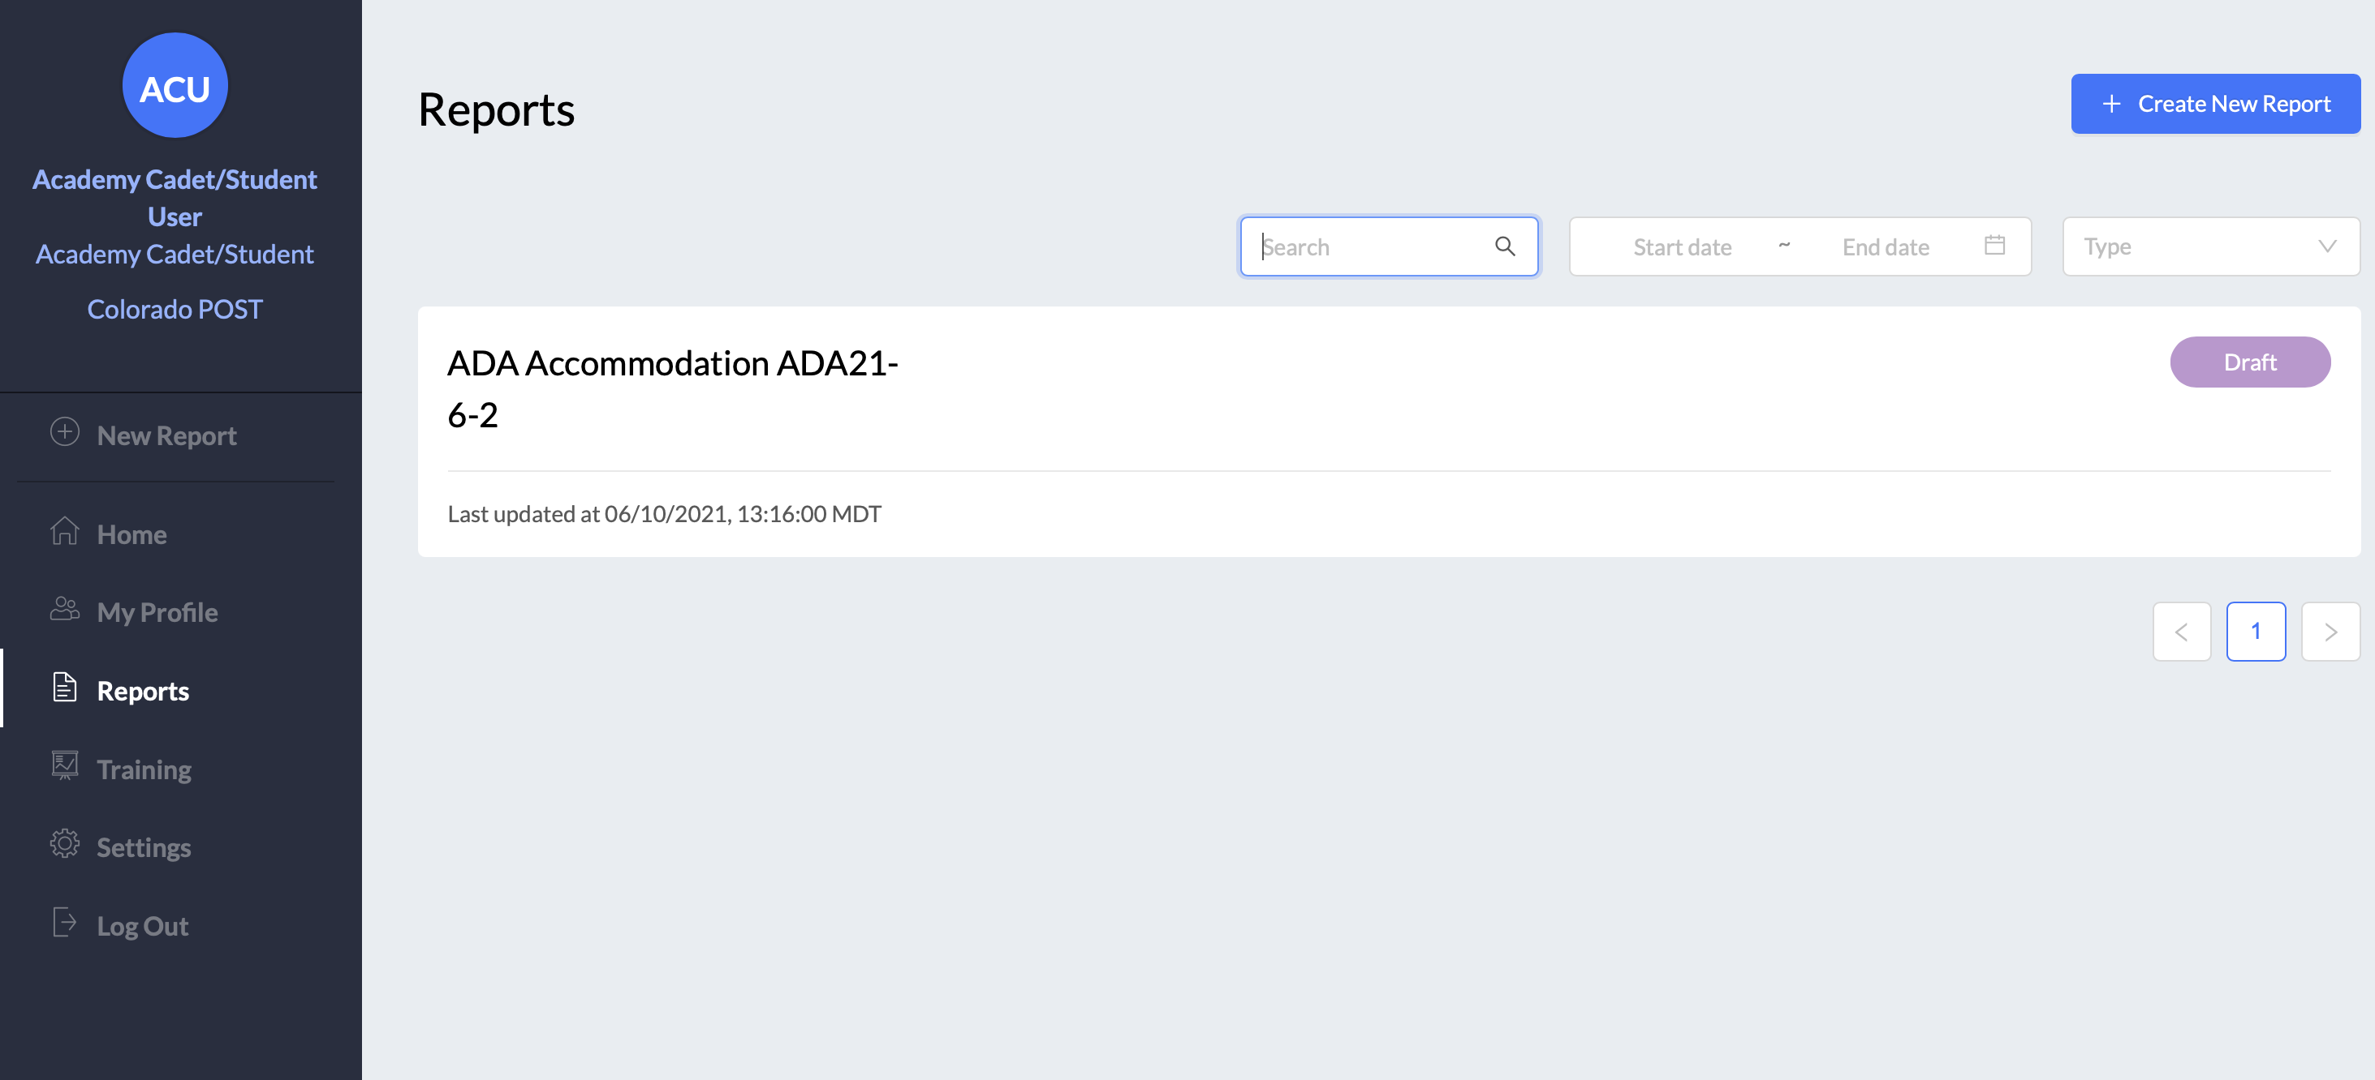
BMS General Navigation: Reports
Cadet Student Experience
Reports: Access reports in draft status; see reports that the user has submitted or reviewed
The submitter sees submitted reports.
The reviewer as part of the report workflow sees associated reports.
Menu item is viewable by all account holders. Reports are visible only to authorized users, as configured.

Slide 11
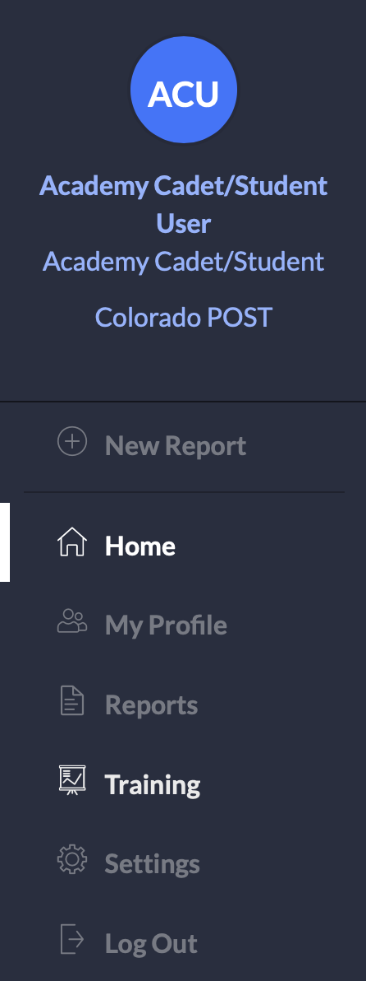
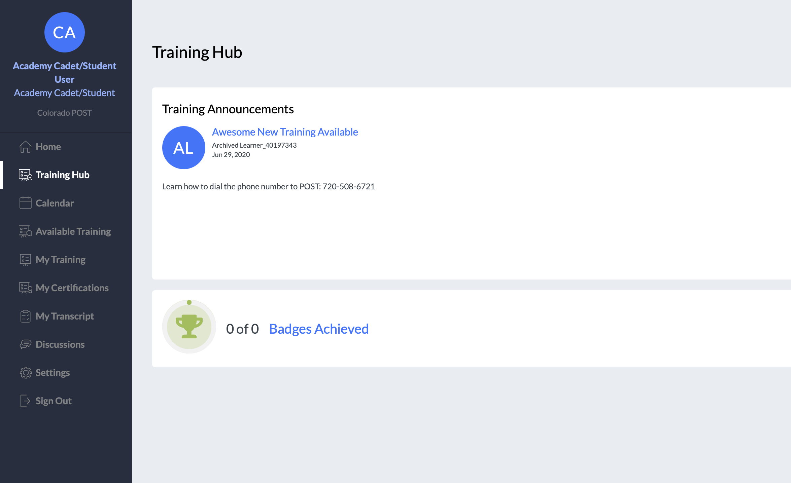
BMS General Navigation: Training Management System
Cadet Student Experience
Clicking “Training” takes the Academy Cadet Student to the Training Management System, where eligible users will complete the POST Exam at the end of the academy.

Slide 12
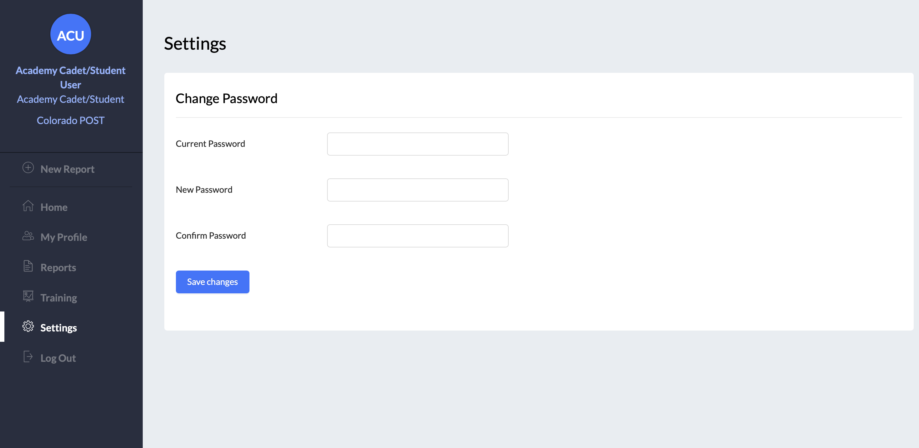
BMS General Navigation: Settings, Log Out
Cadet Student Experience
Settings: Within the system all users have the ability to reset the password. The current password must be known.

Slide 13
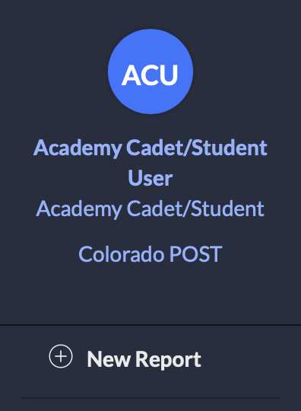
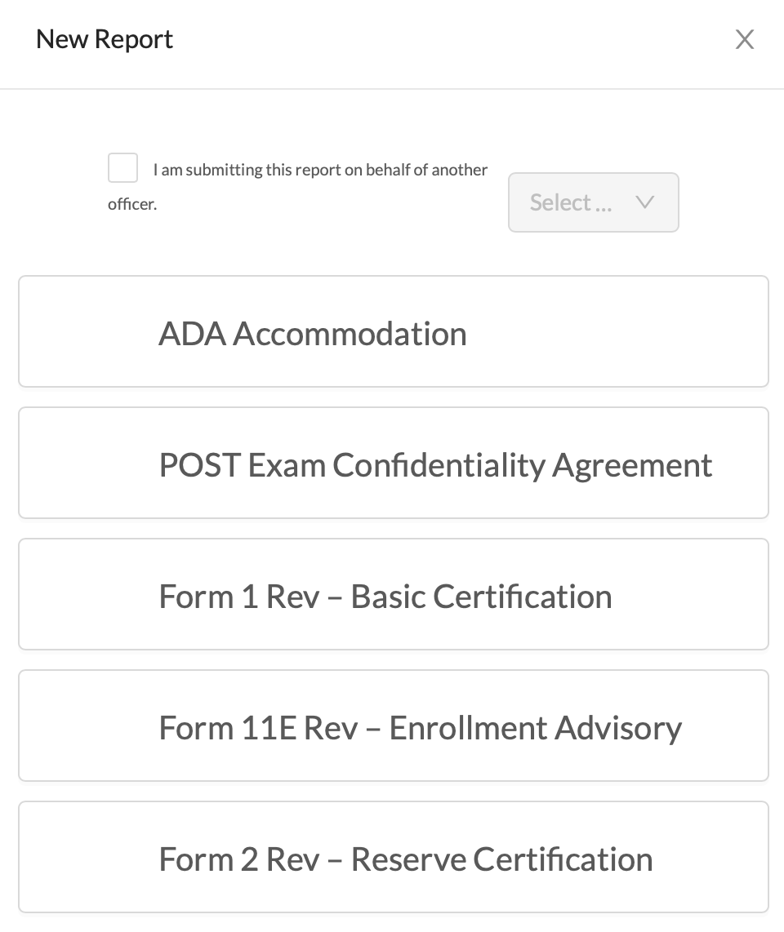
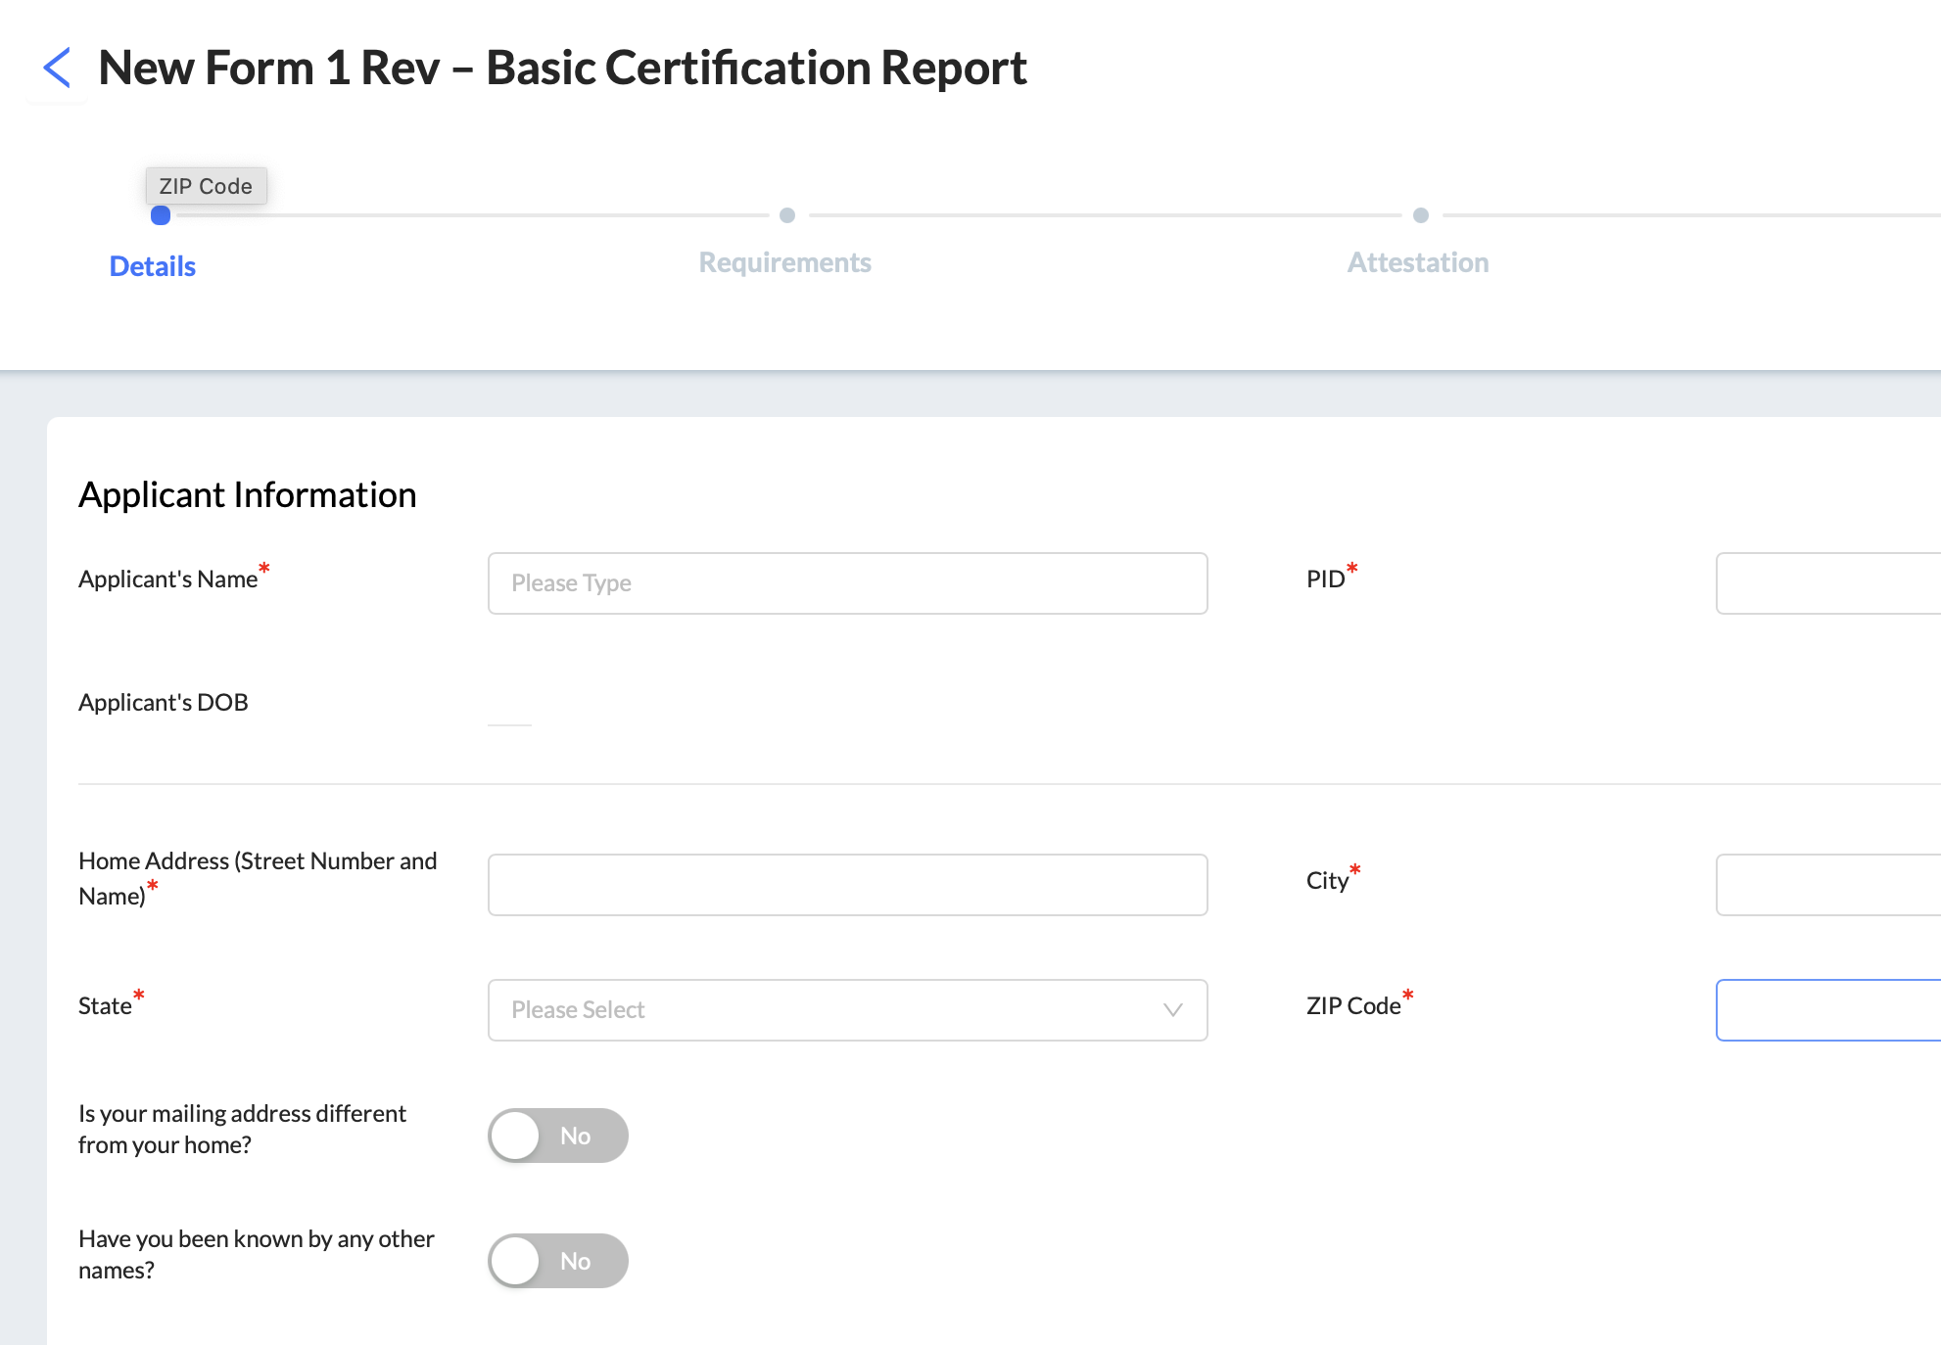
Forms: Report Creation
Cadet Student Experience
The creation of all report types is managed through the “+ New Report” menu panel item. User can click on the text to display the list of available CO POST reports.
Reports are viewable to users whose role starts a report workflow, based on CO POST configurations.

Slide 14
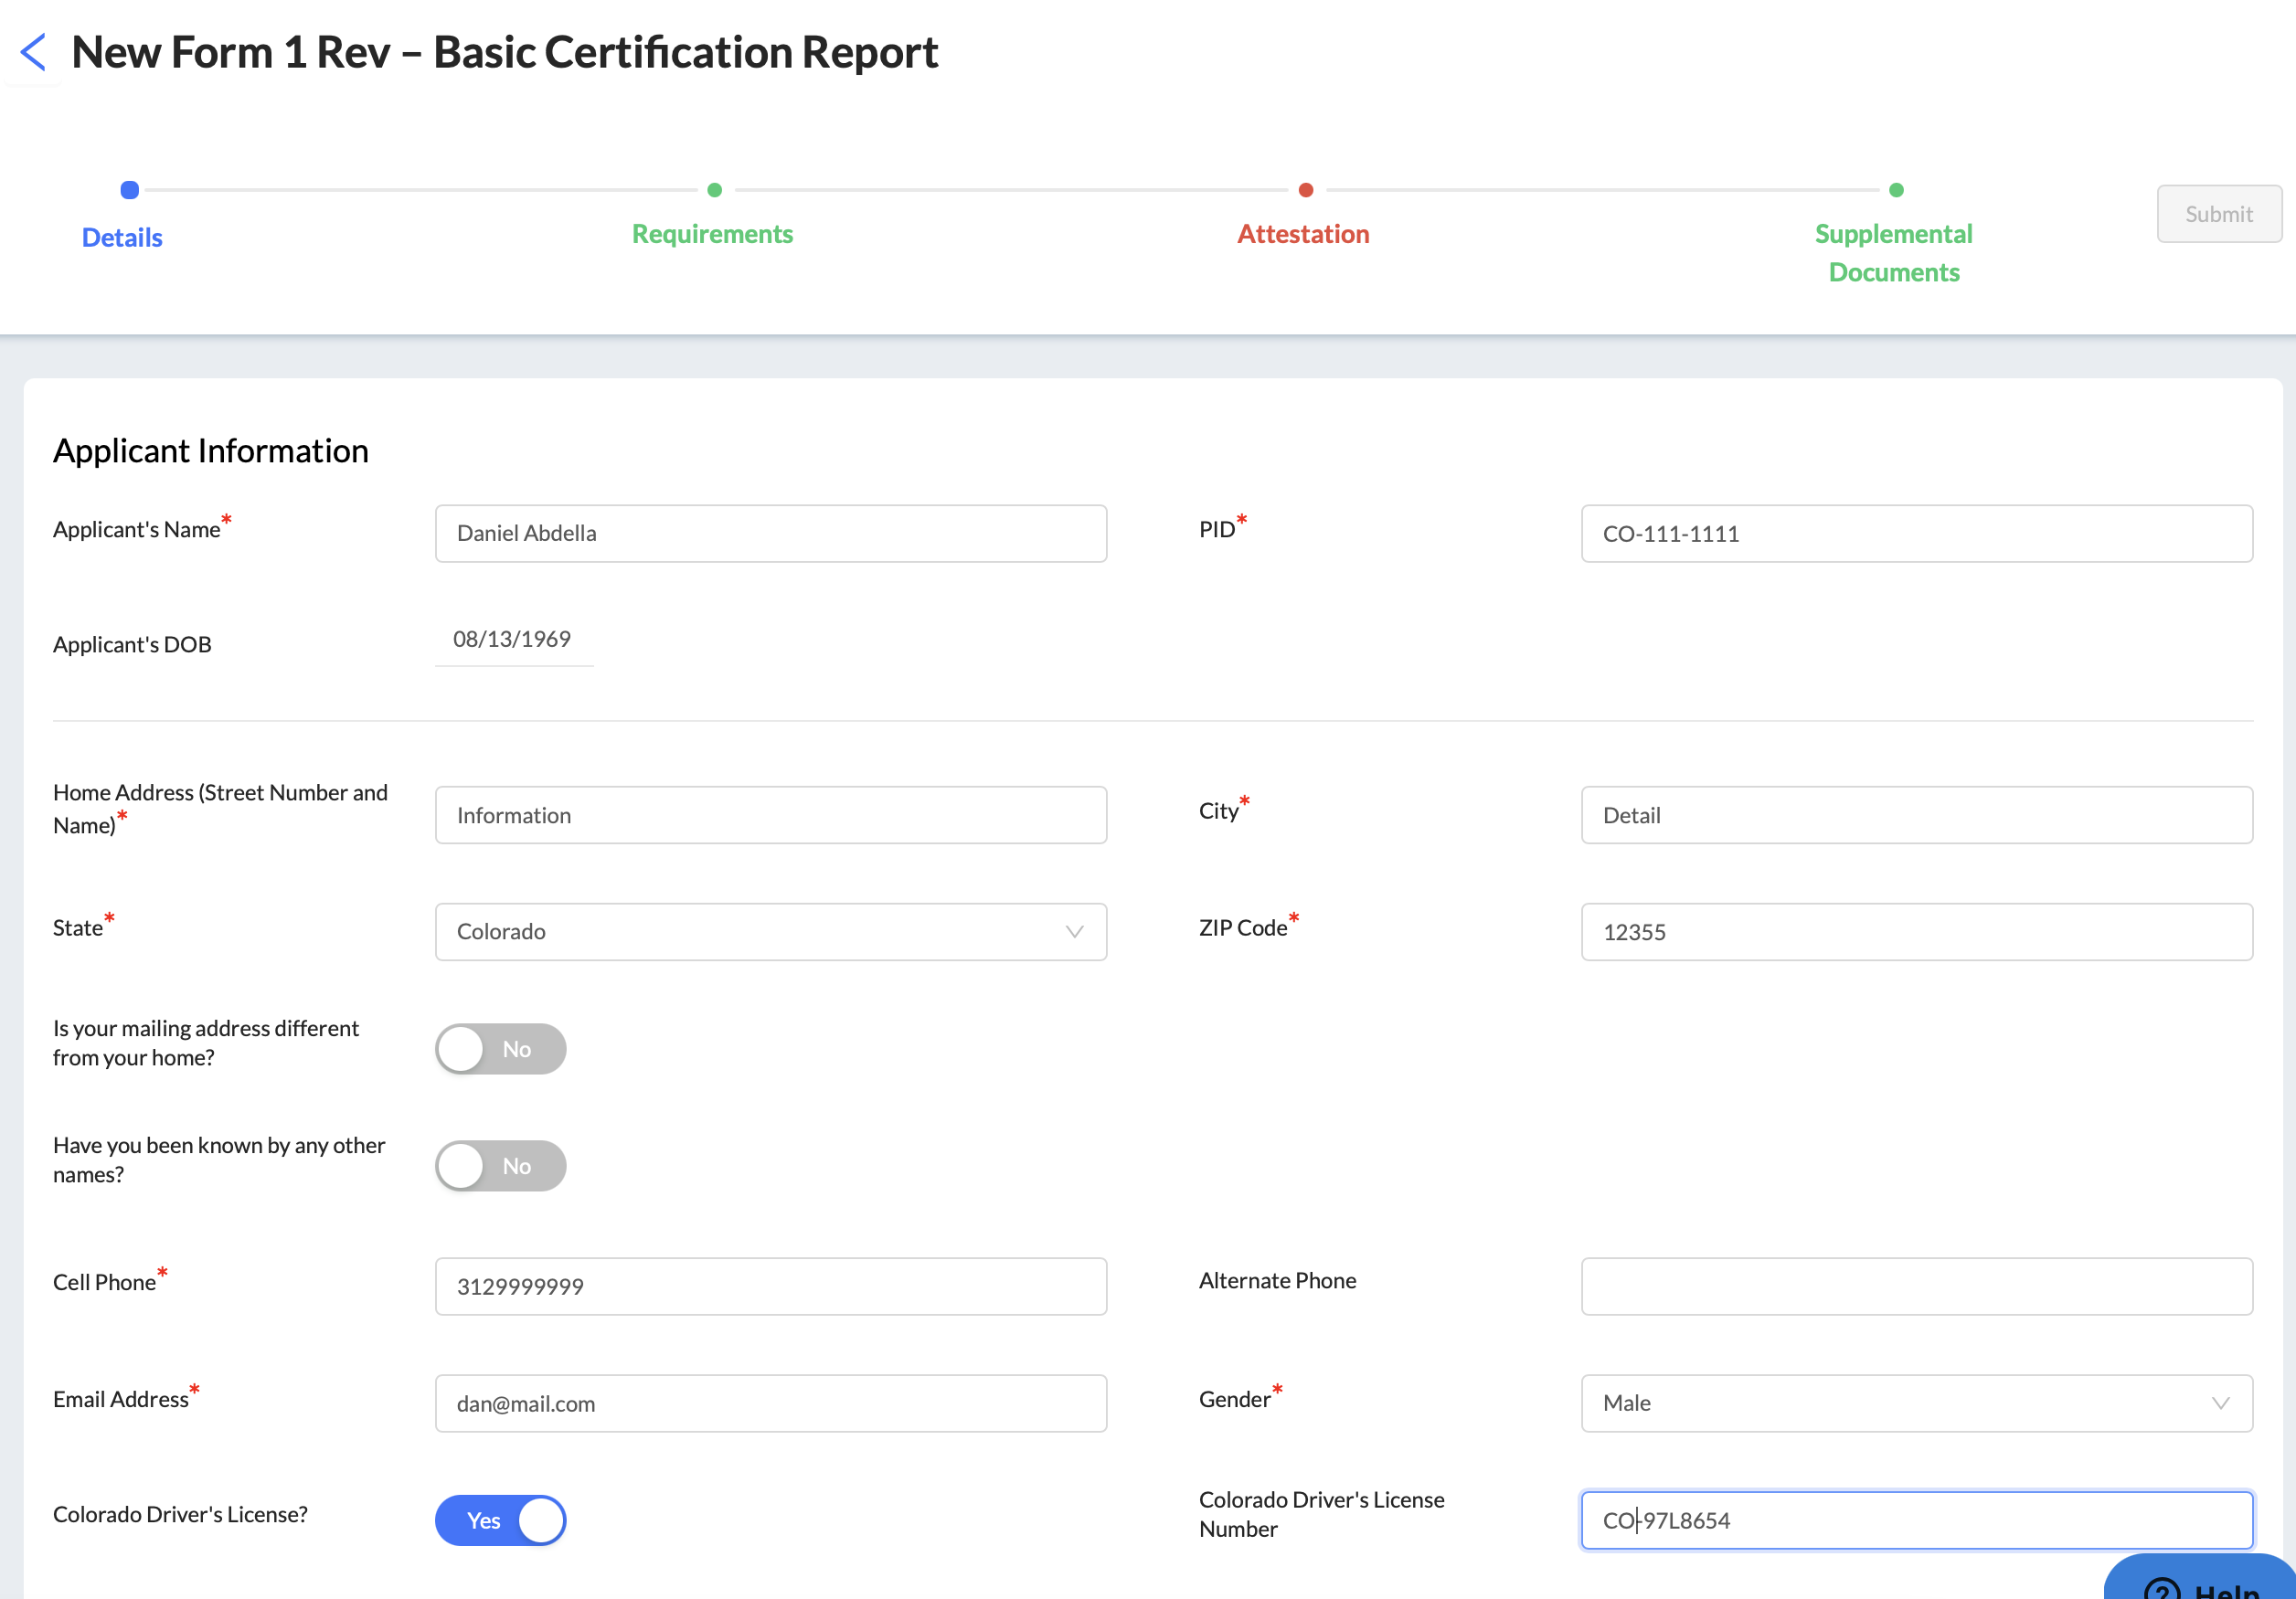
Forms: Report Completion
Cadet Student Experience

Slide 15
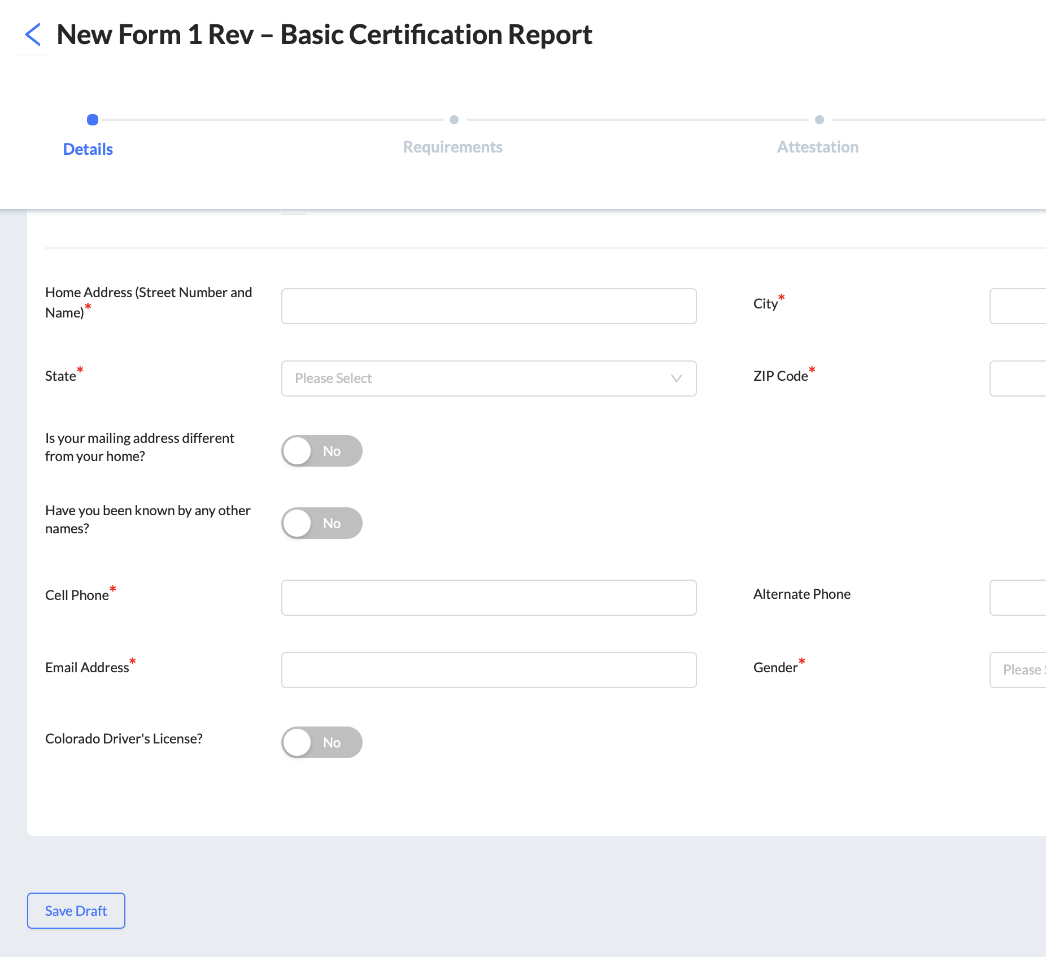
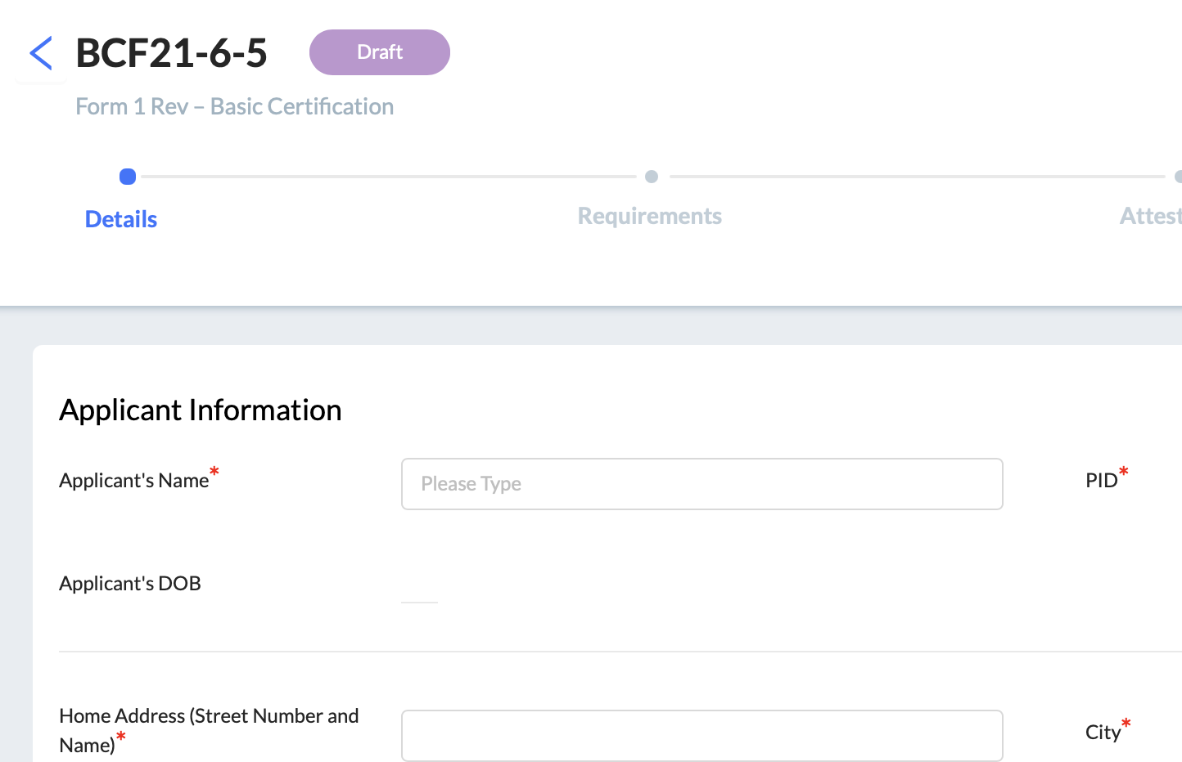
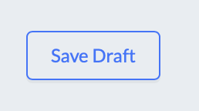
Forms: Report Completion – Save Draft
Cadet Student Experience
Users are encouraged to save draft regularly to retain progress.

Slide 16
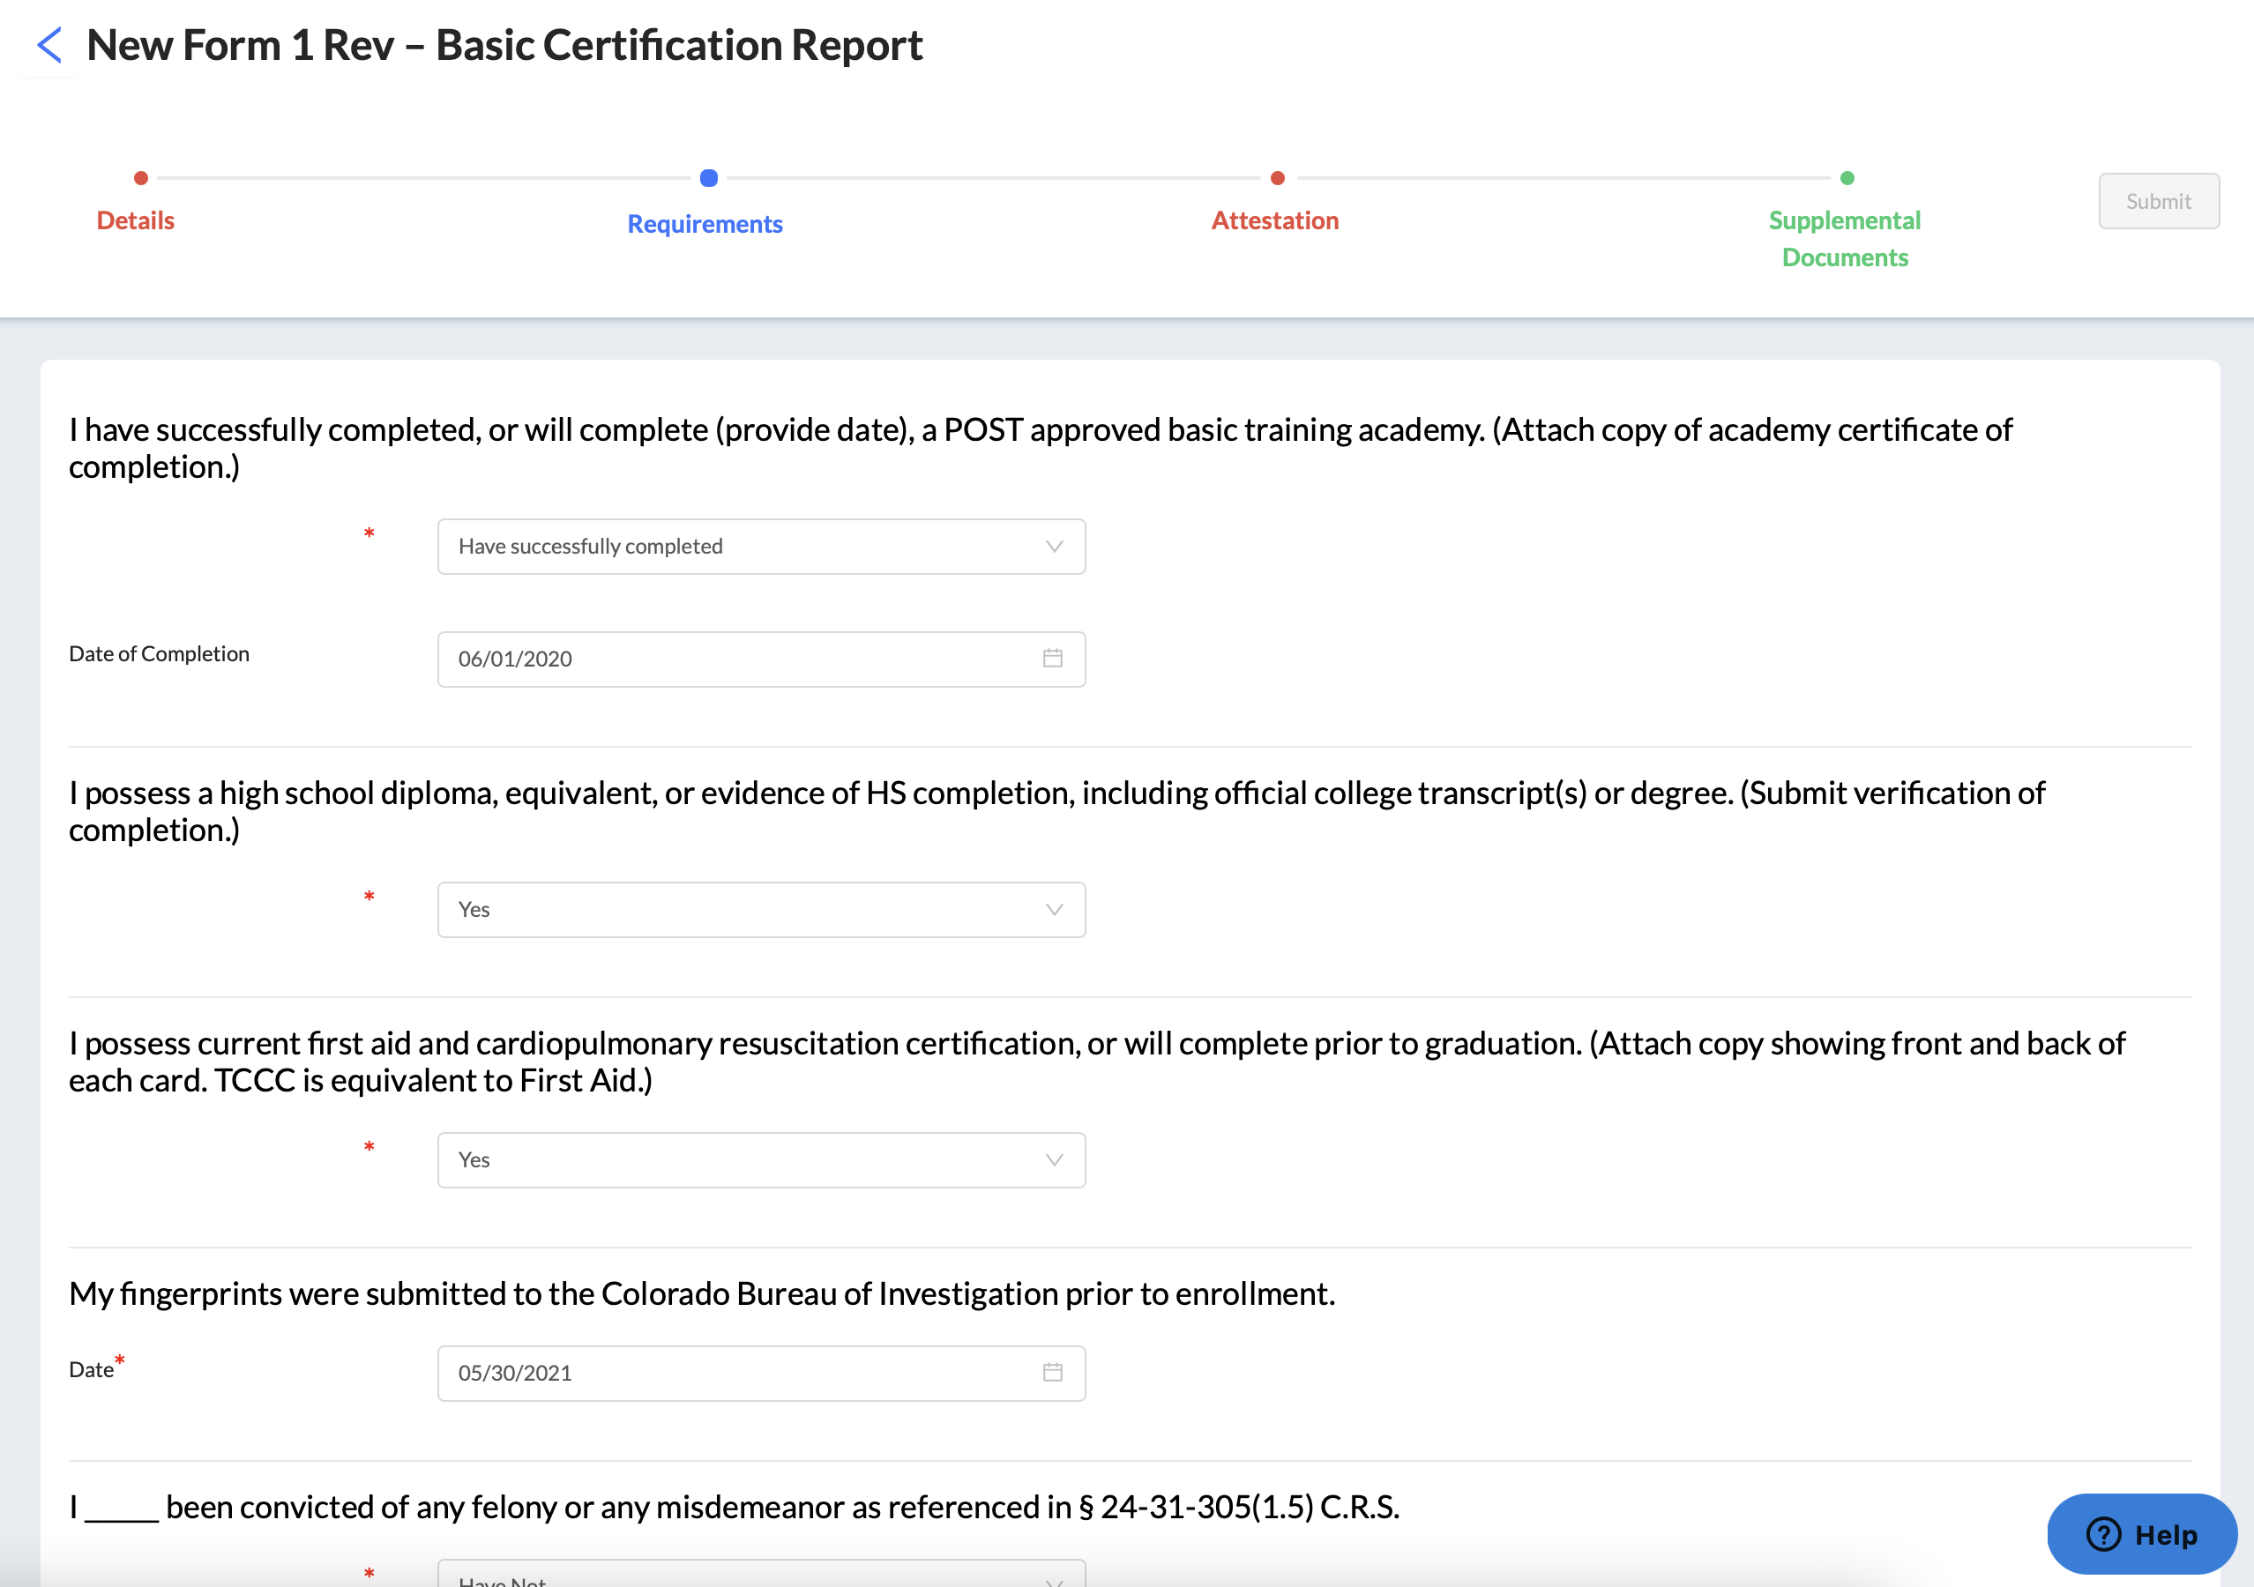
Forms: Report Completion
Cadet Student Experience

Slide 17
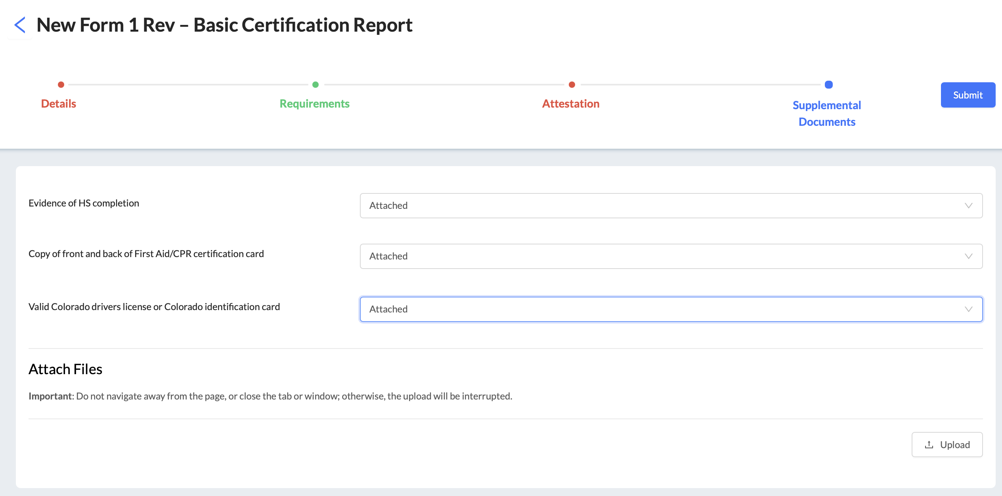
Cadet Student Experience
Forms: Report Completion
Click submit to send to Colorado POST

Slide 18
Benchmark Management System (BMS) ___ Academy Admin / Academy Director Experience

Slide 19
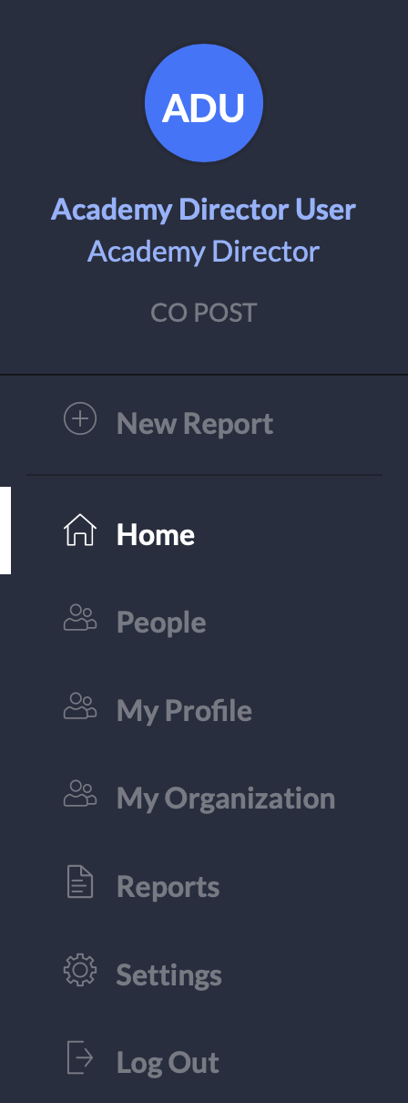
BMS General Navigation
Academy
Director / Admin Experience
Description
(+) New Report: Create a new report based on your role(s).
Home: Main landing page upon login. View and take action on Action Items and see Current Activities for reports in progress.
People: Displays all academy staff.
My Profile: Logged in user’s profile information.
My Organization: Brief details related to user’s academy.
Reports: Access reports in draft status; see reports that the user has submitted or reviewed.
Settings: Only visible to administrators and administrator functions will vary depending on assigned administrator roles.
Log Out: Will sign you out of your account.

Slide 20
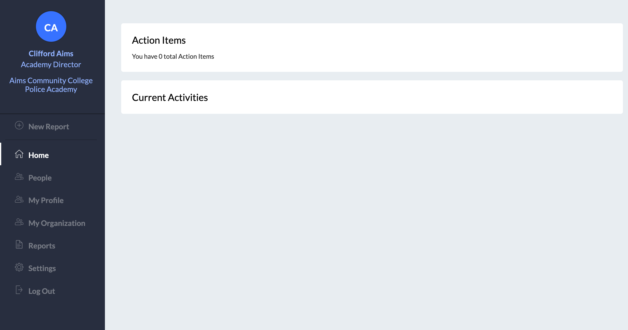
BMS General Navigation: Home
Academy
Director / Admin Experience
The Home tab navigates the user to the listing of Action Items and Current Activities, displaying the reports, requests for information, and other actions that the user needs to take.

Slide 21
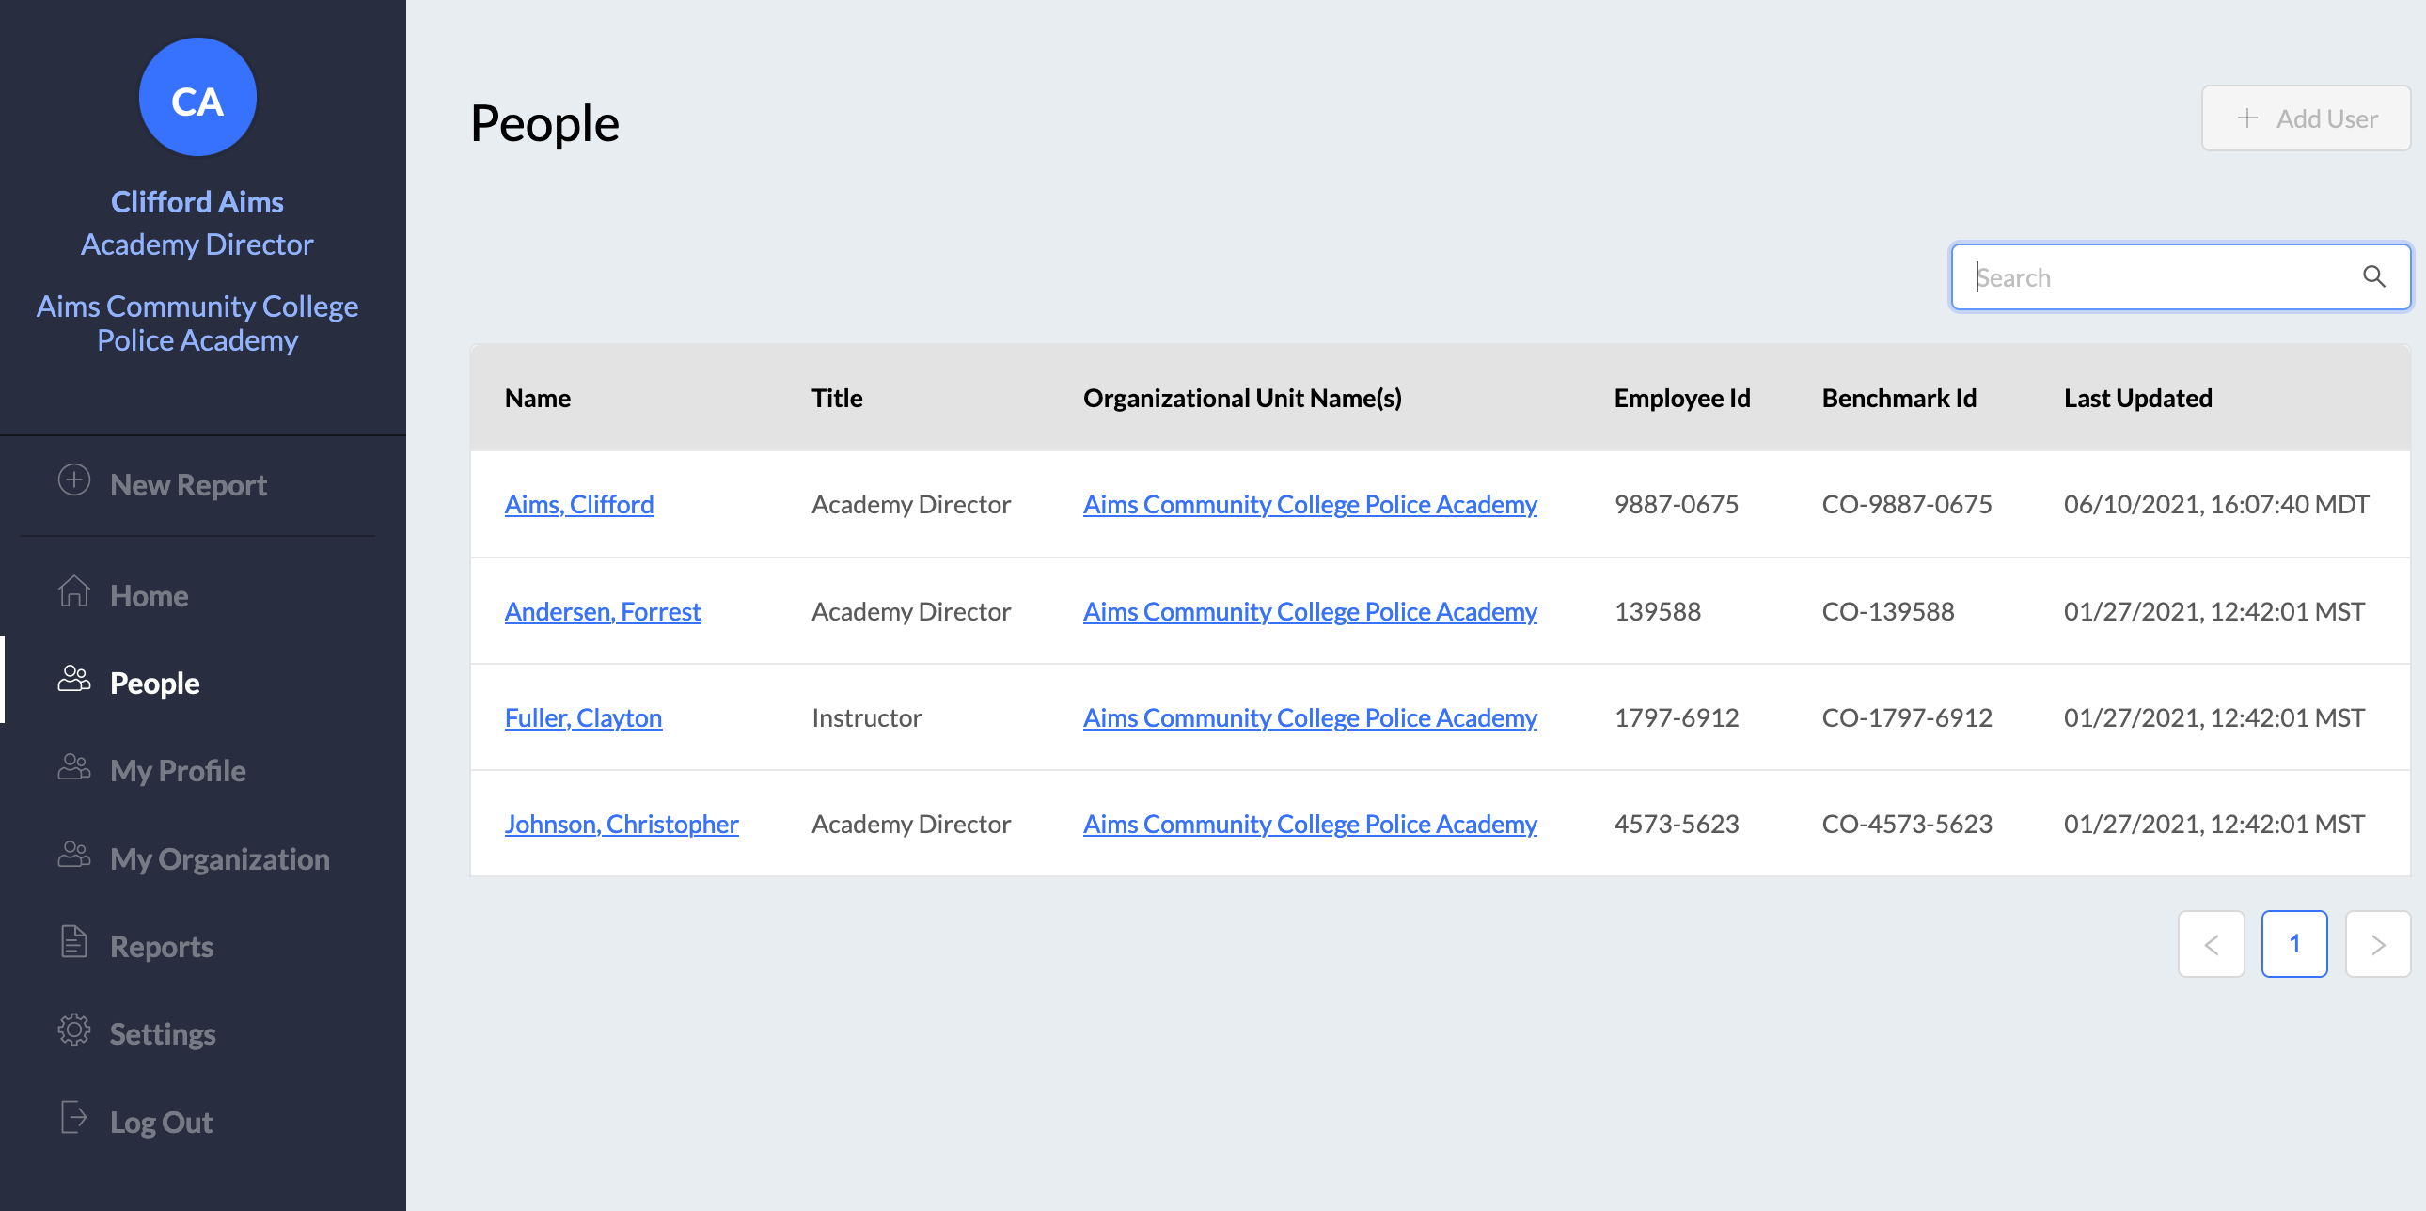
BMS General Navigation: People
Academy
Director / Admin Experience
People: Displays all academy staff.

Slide 22
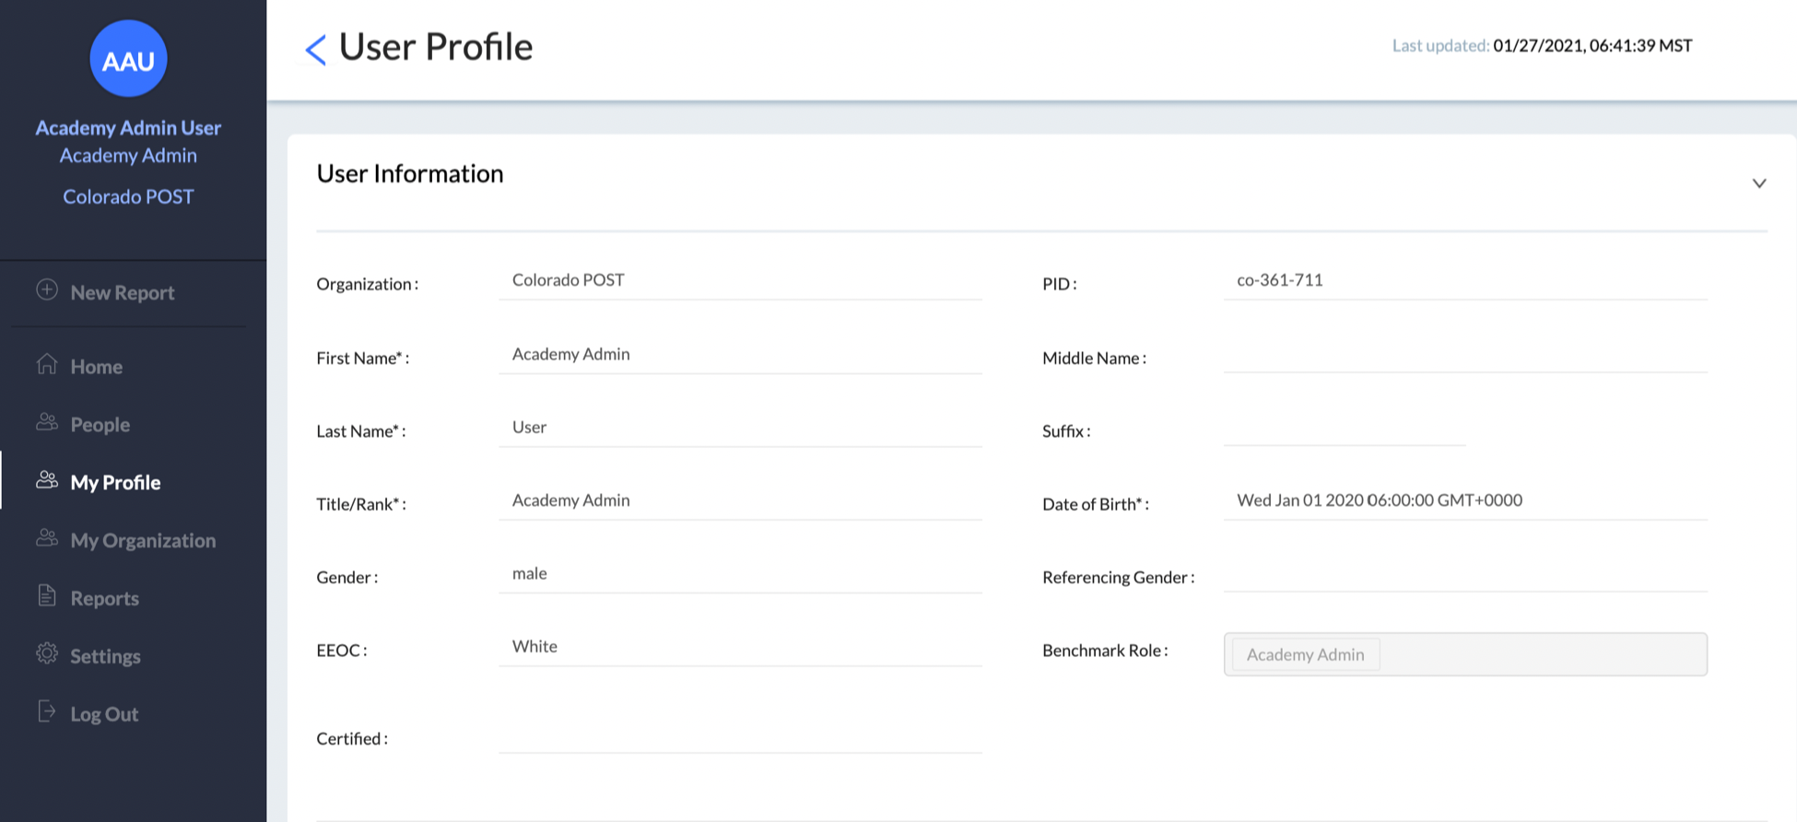
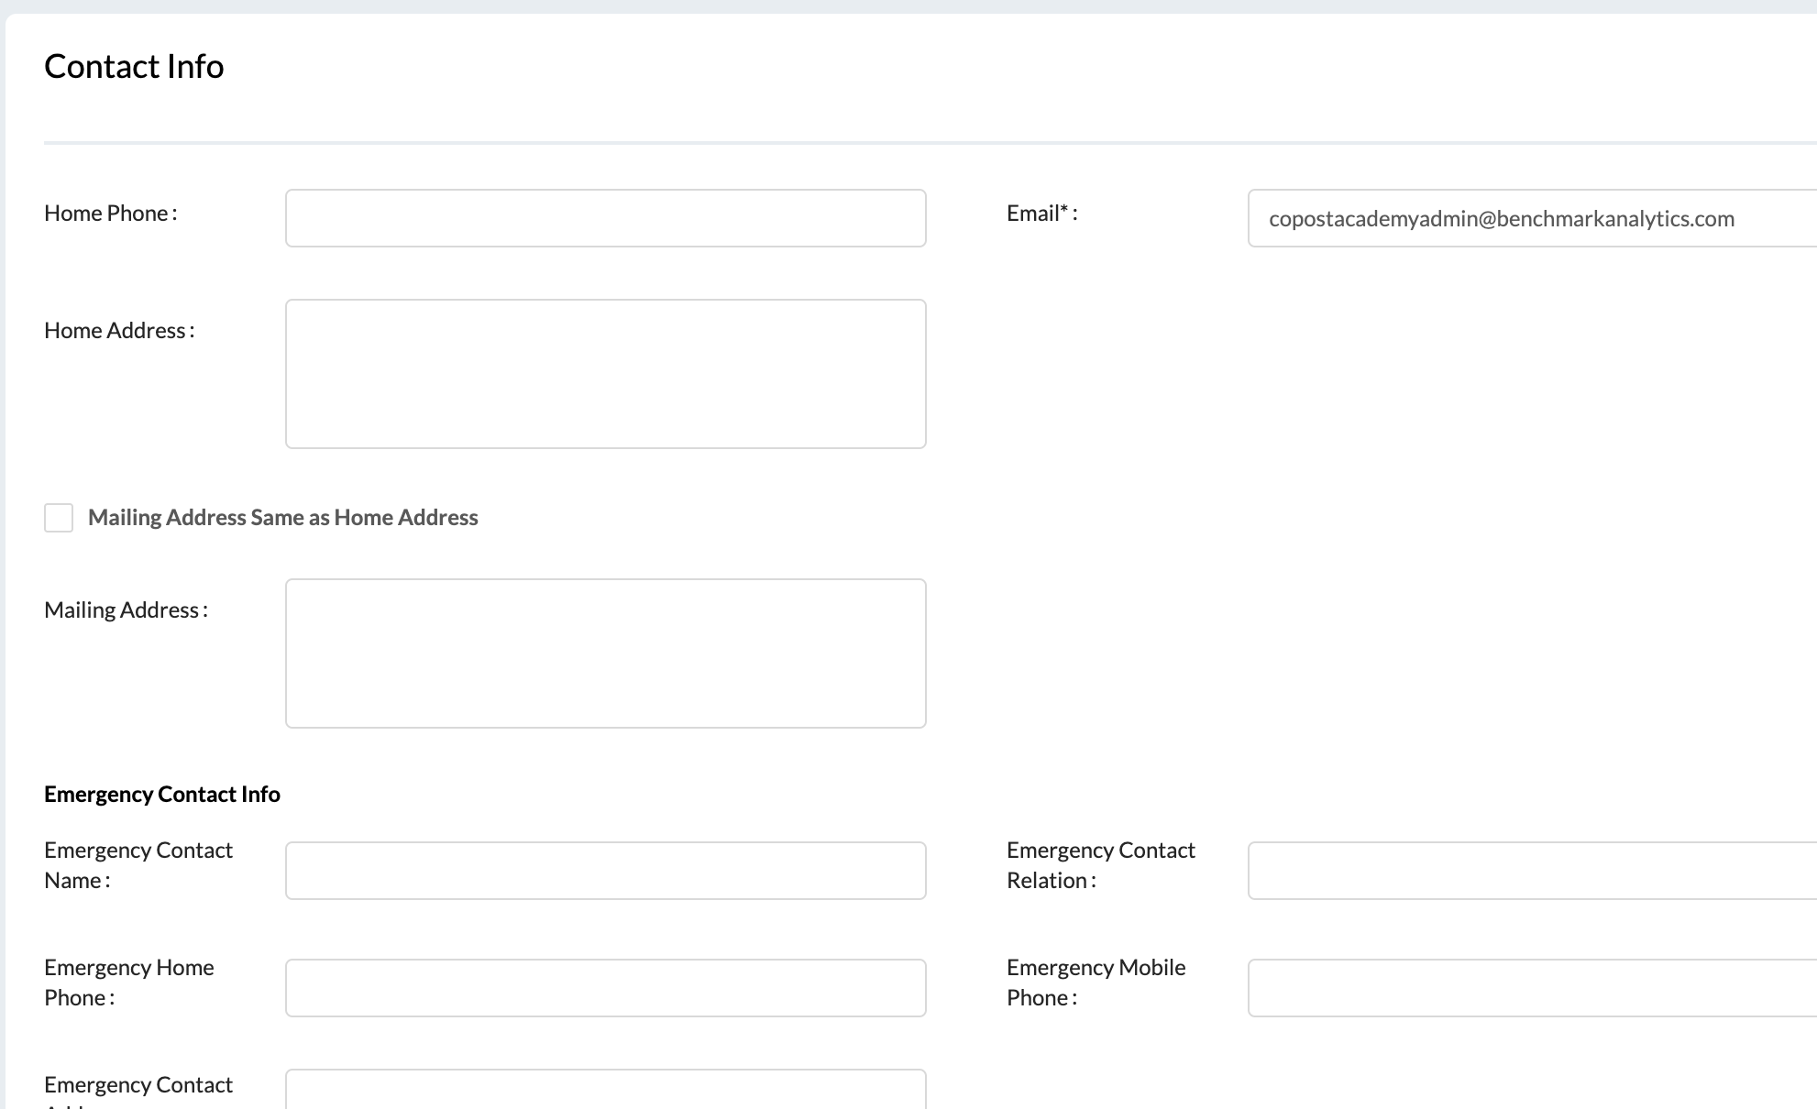
BMS General Navigation: My Profile
Academy
Director / Admin Experience
My Profile: Logged in user’s profile information.

Slide 23
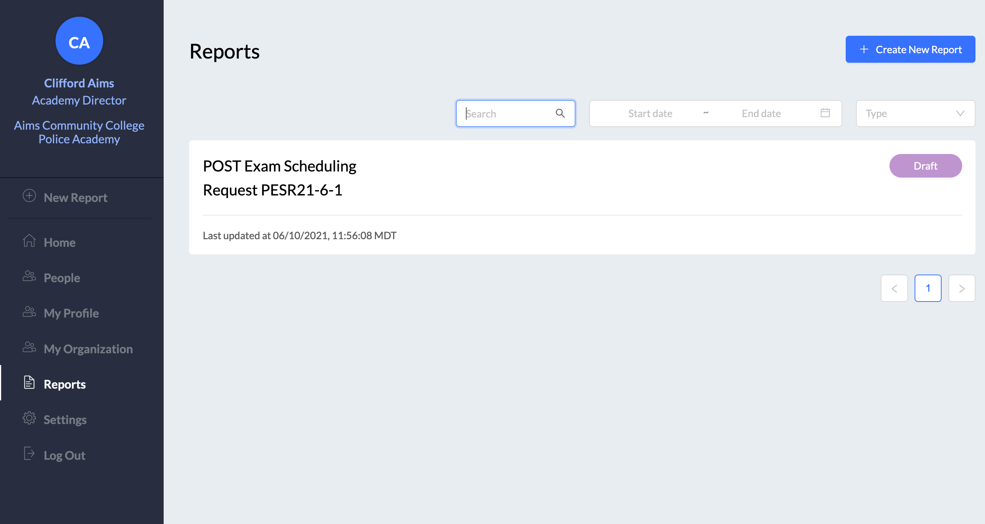
BMS General Navigation: Reports
Academy
Director / Admin Experience
Reports: Access reports in draft status; see reports that the user has submitted or reviewed
The submitter sees submitted reports.
The reviewer as part of the report workflow sees associated reports.
Menu item is viewable by all account holders. Reports are visible only to authorized users, as configured.

Slide 24
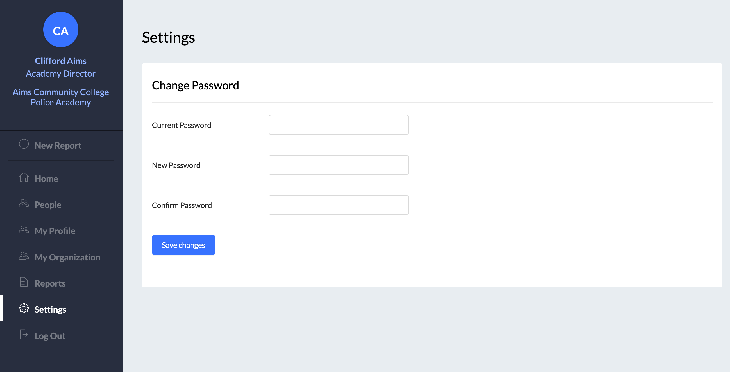
BMS General Navigation: Settings, Log Out
Academy
Director / Admin Experience
Settings: Within the system all users have the ability to reset the password. The current password must be known.

Slide 25
Report Processes

Slide 26
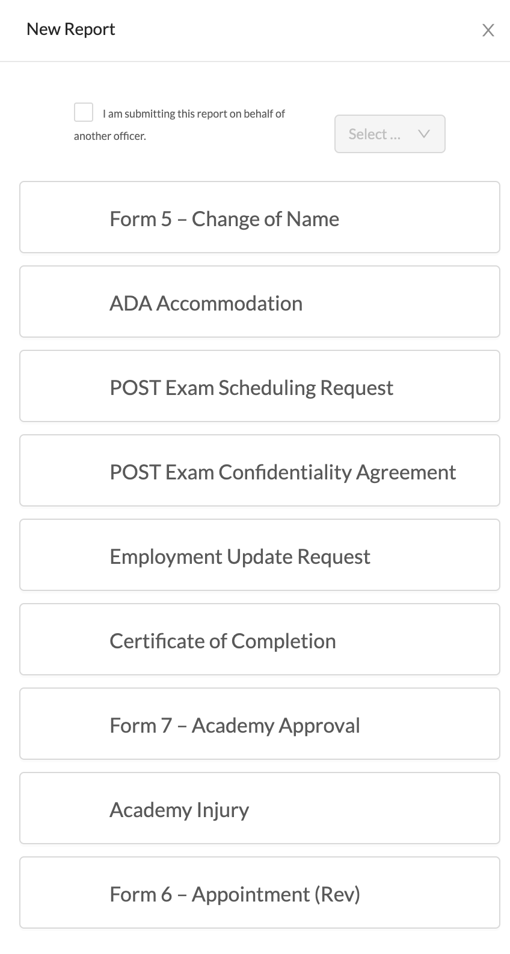
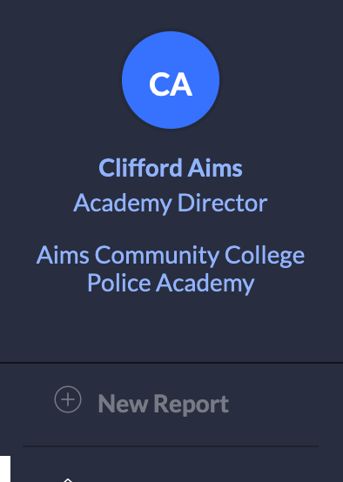
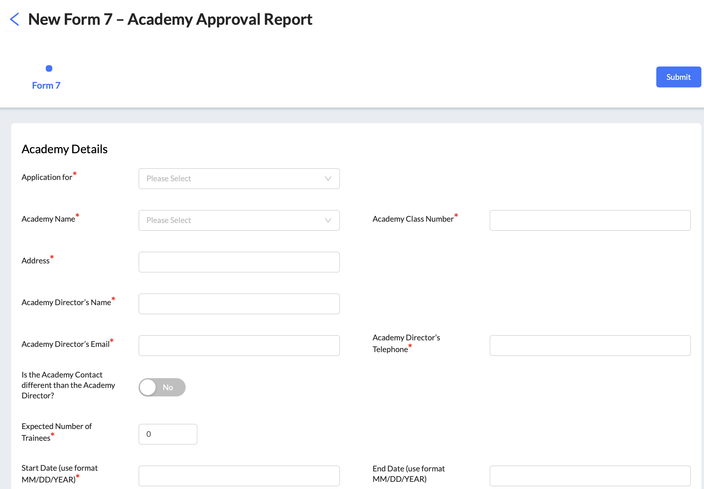
Forms: Report Creation
Academy
Director / Admin Experience
The creation of all report types is managed through the “+ New Report” menu panel item. User can click on the text to display the list of available CO POST reports.
Reports are viewable to users whose role starts a report workflow, based on CO POST configurations.

Slide 27
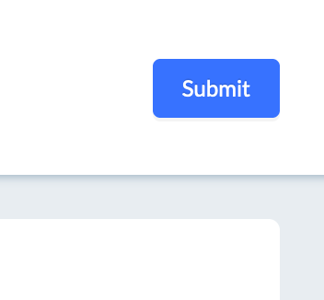
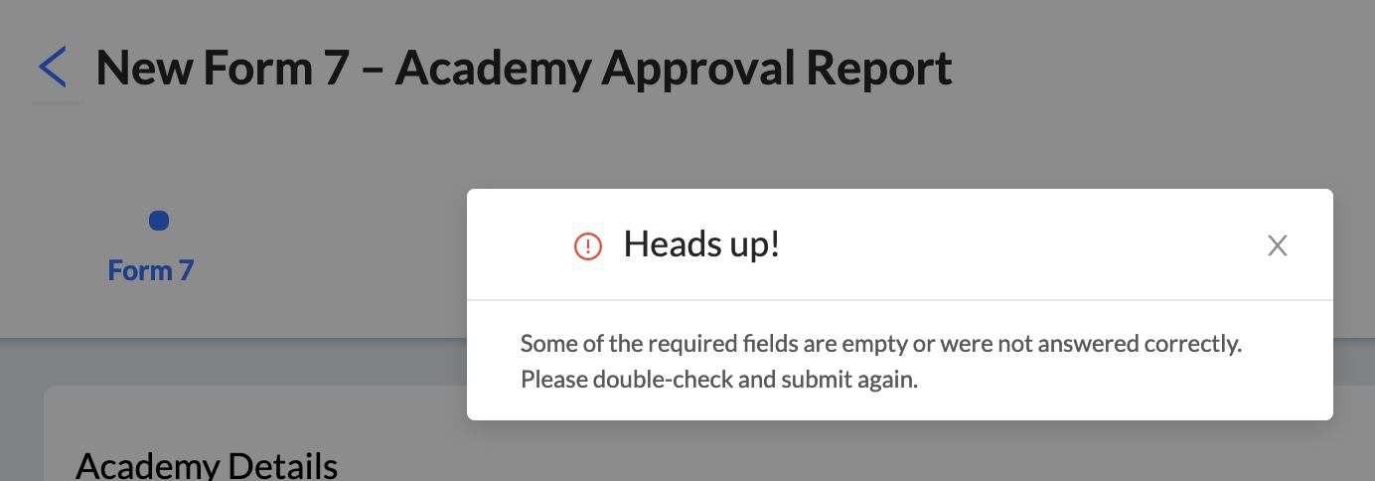
Academy
Director / Admin Experience
Form Attributes: Heads up!
After the submitter has added all information, click the “Submit” button.
If any required fields have not been completed, the system will alert the user and highlight the sections of the report needing attention.

Slide 28
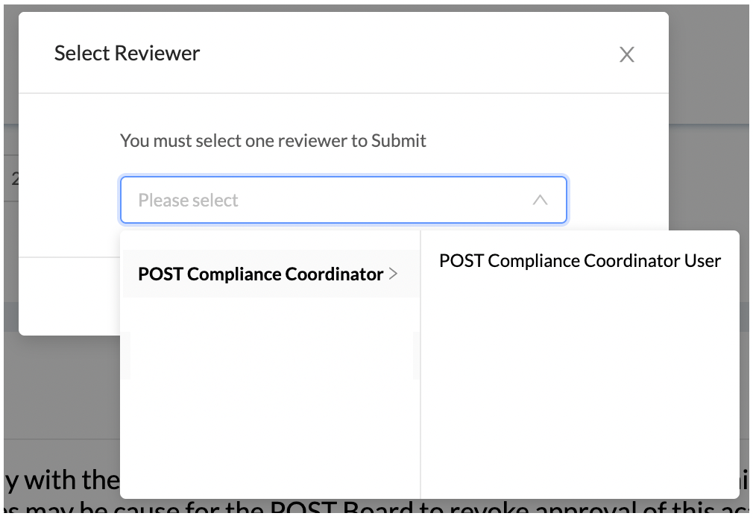
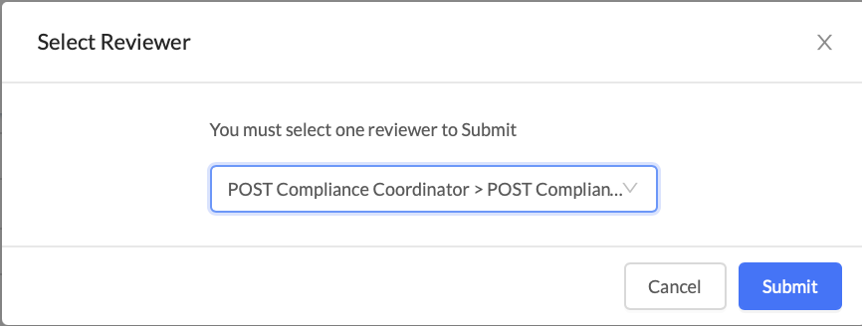
Report Attributes: Report Submission
Academy
Director / Admin Experience
After the Submitter clicks “Submit” and successfully sends the report, a success message will be displayed
The Reviewer sees an action item and can “Take Action”.

Slide 29
Academy
Director / Admin Experience
BMS “Take Action”: Email Notifications
Subject: Please review Form 7 - Academy Approval report:
You have a <TAKE ACTION> on AAA21-1-2.
Submitted to you by USER
Originally created by USER
Please click <TAKE ACTION> to access the report (https://bms.benchmarkonline.app/reports/####)
If you need assistance, please email support@benchmarkanalytics.com.
Benchmark sends the above email to the user that a system action is required.
Agency Director / Admin users may receive a notification if POST requests additional information related to a submitted form.

Slide 30
Form/Report Functions

Slide 31
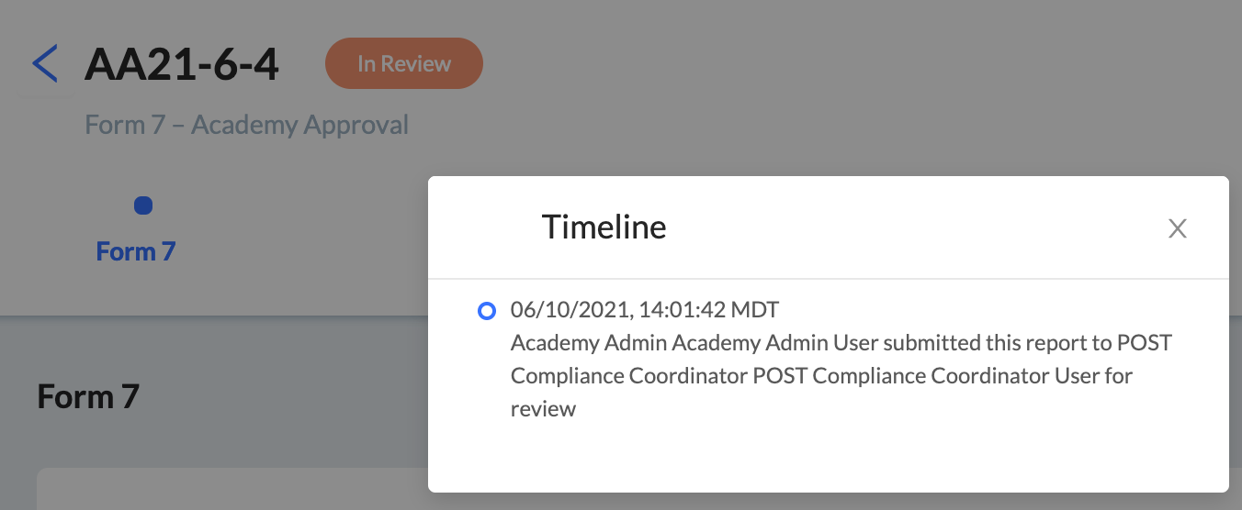
Report Functions: Activity Timeline

Slide 32
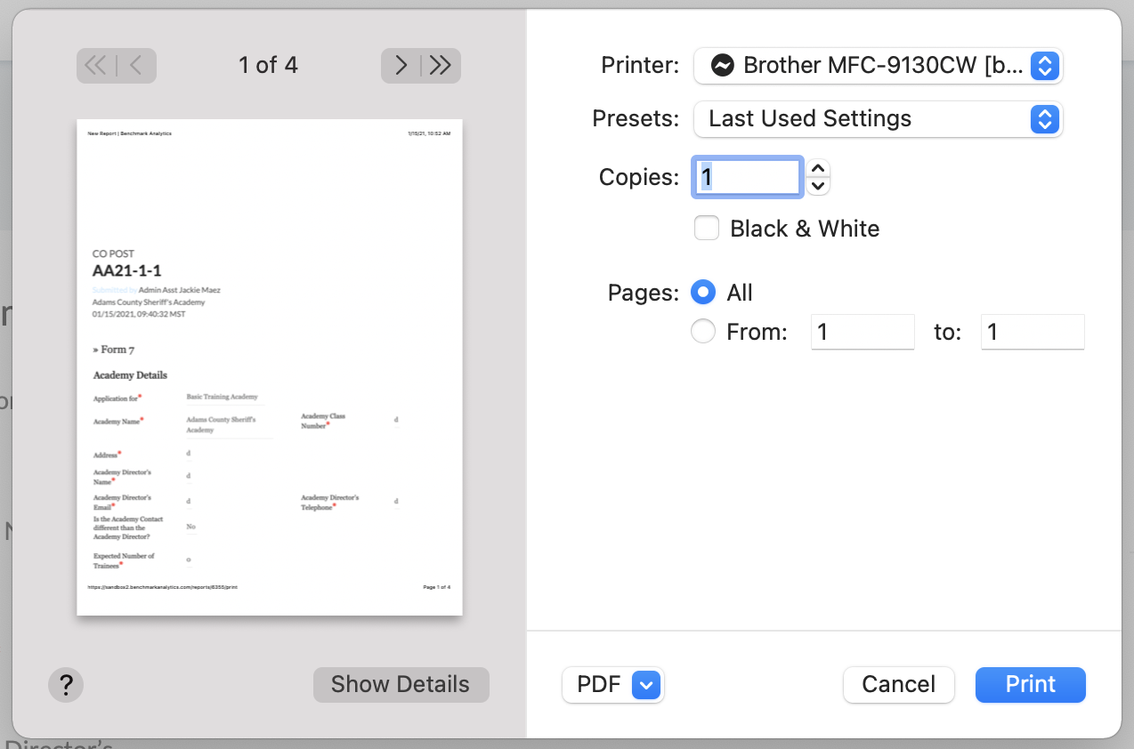
Report Functions: Print

Slide 33
For Questions and System Support: Production

Slide 34
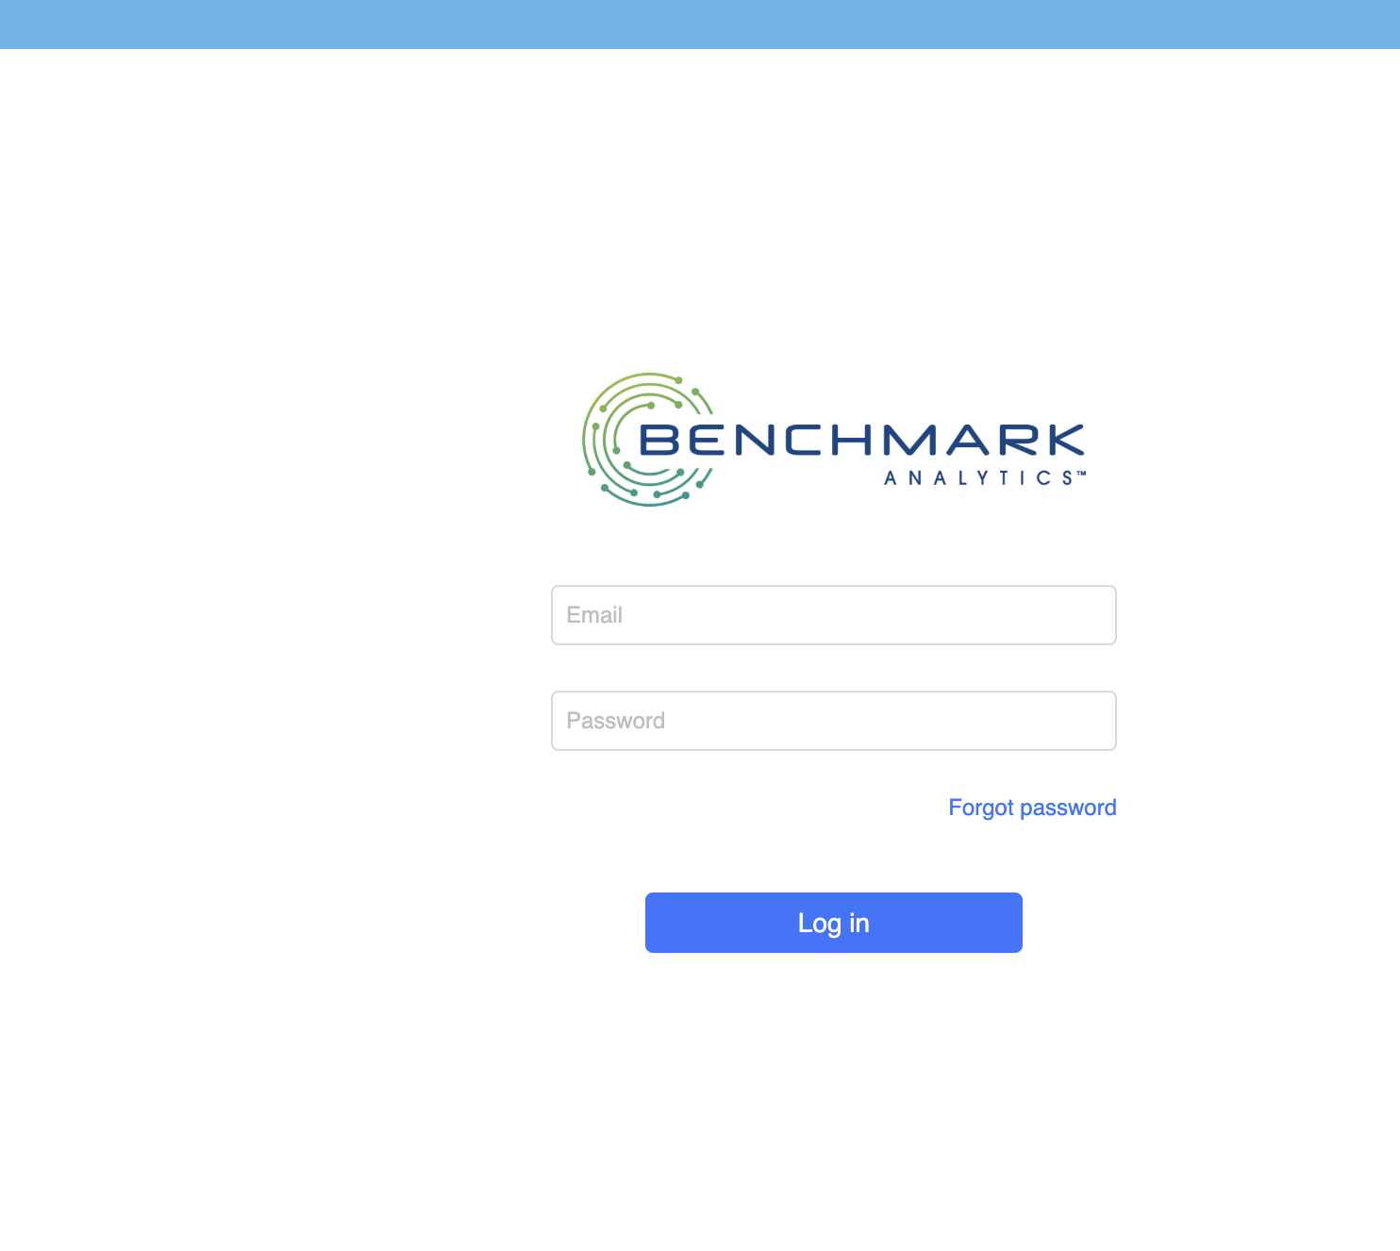
BMS: First Time Login
Open a new browser and go to URL: https://bms.benchmarkonline.app/
This permanent link takes users to the Production site
Standard browsers are Chrome, Edge, Firefox, Safari
Internet Explorer may not provide the optimal site experience
At the login page click “Forgot password” under the Password field.
Enter the your PID number (adding prefix “CO-”) and click the Submit button.
Important: to use this feature there must be an email address associated to your Benchmark account

Slide 35
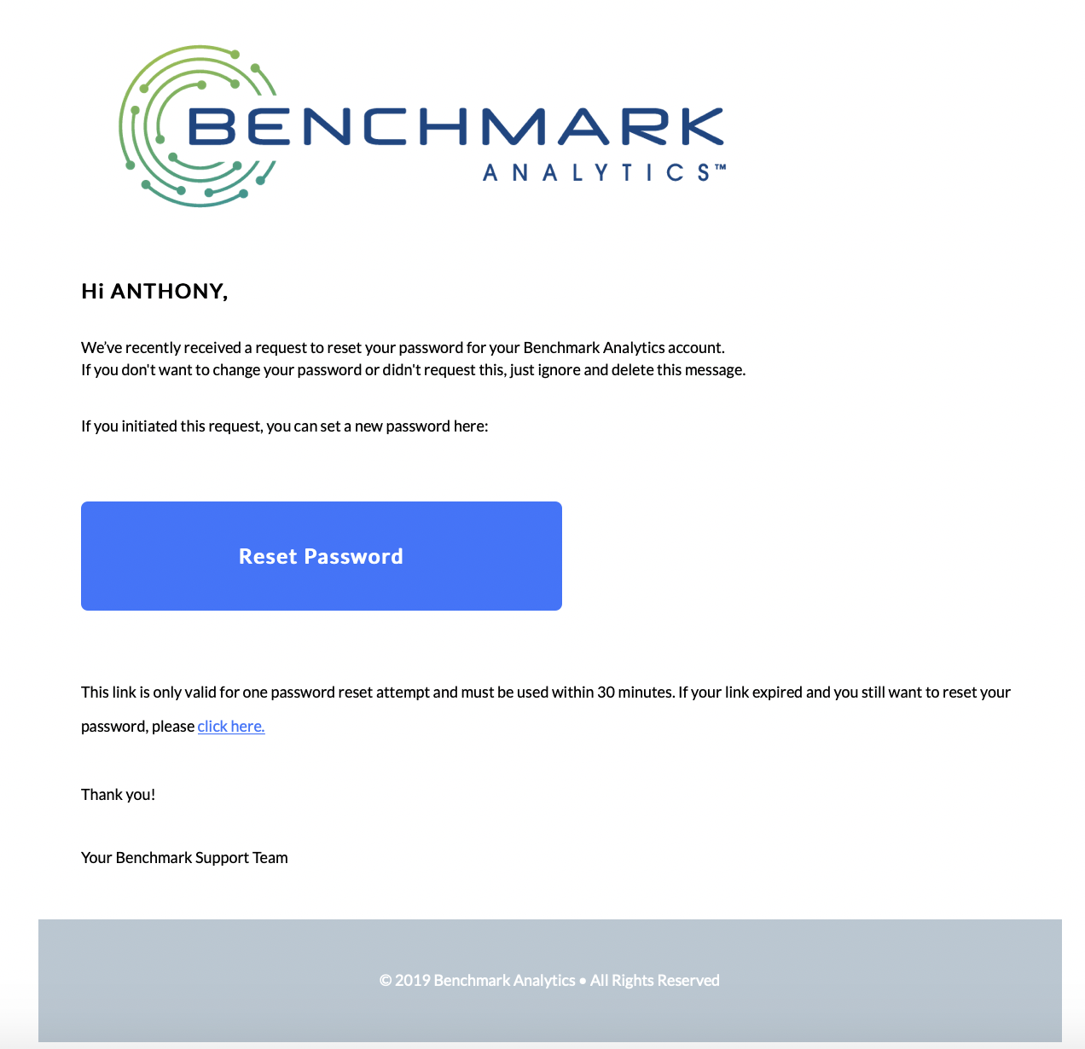
BMS: First Time Login
The user will receive an email from noreply@benchmarkanalytics.com with a link for “Reset Password”.
Click the “Reset Password” button to reset your password and login.

Slide 36
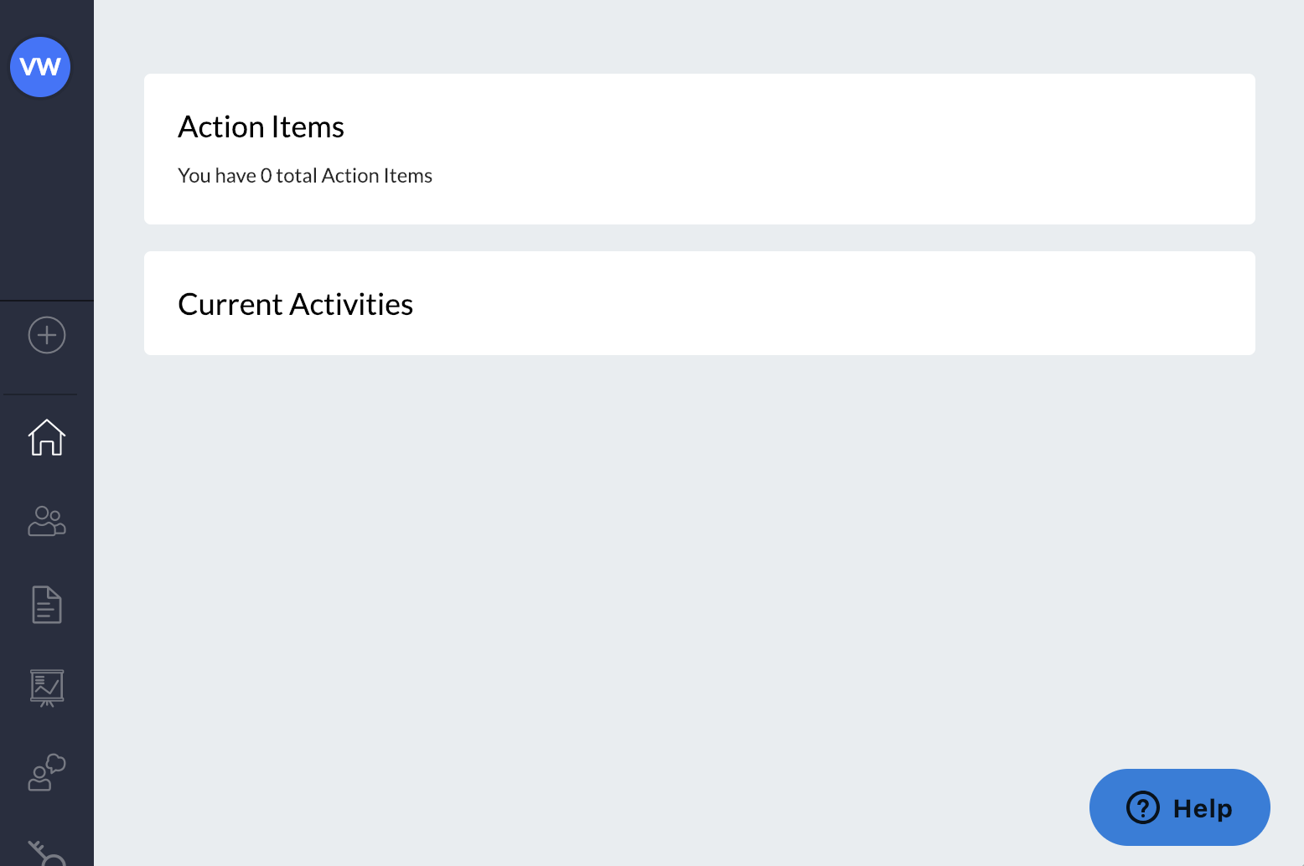
Benchmark In-System Support
You may submit a support case directly to the Benchmark Support team while logged in by clicking on the blue “Help” button at the bottom right of any screen.

Slide 37
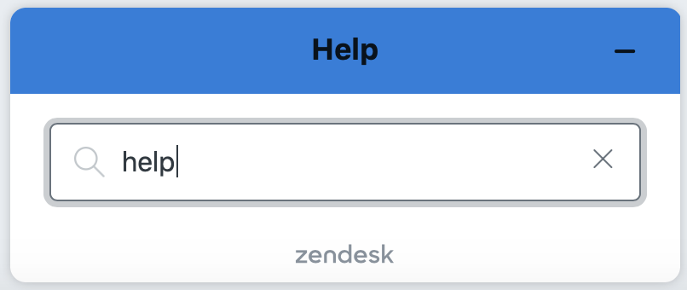
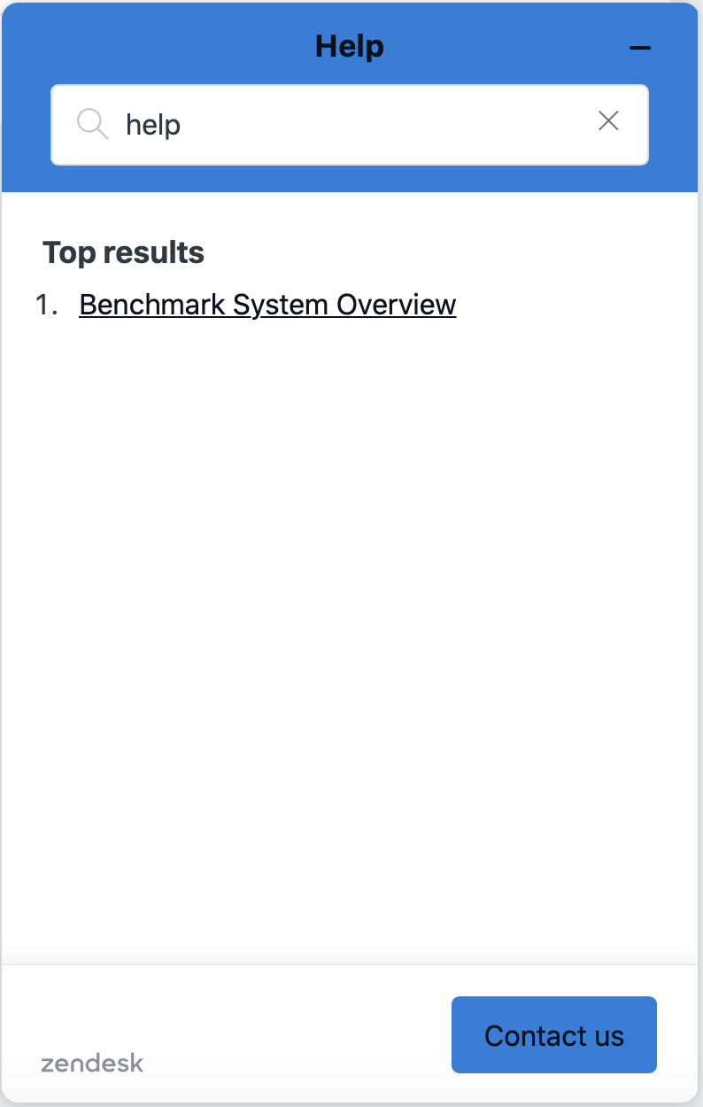
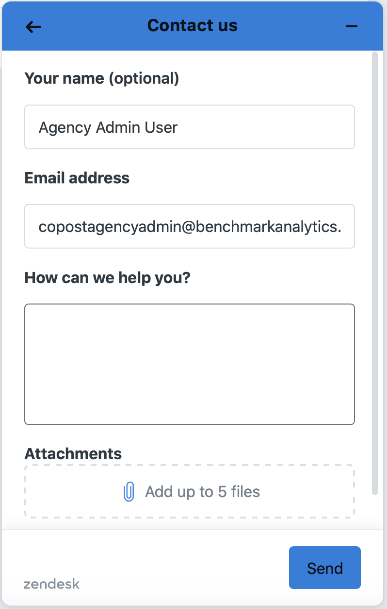
Benchmark In-System Support
After clicking “Help” the system provides the user an opportunity to first search the knowledge base for a support article
Users can then use “Contact us” to connect directly to the Support team.
The system will automatically pull in your name and email address.
Screenshots are awesome. Show us as much detail as possible regarding the issue you are experiencing. This helps our team quickly understand the need.
Click “Send” and a new ticket will be created. A member of our team will respond shortly.

Slide 38
Contact Colorado POST for…
Forgot PID Number
Process related questions
Email: post@coag.gov
Academy Email: POSTAcademy@coag.gov
For PID creation: Submit Name, DOB, Email Address, Academy Name
Phone: 720-508-6721
Contact Benchmark Analytics for…
Forgot password
Technical support questions or to open a support case
Help icon inside BMS
Email: support@benchmarkanalytics.com
Phone: 888-40BENCH, option 2

Slide 39
Questions

Slide 40
Appendix _________

Slide 41
Cadet Forms: Form 1 – Basic Certification

Slide 42
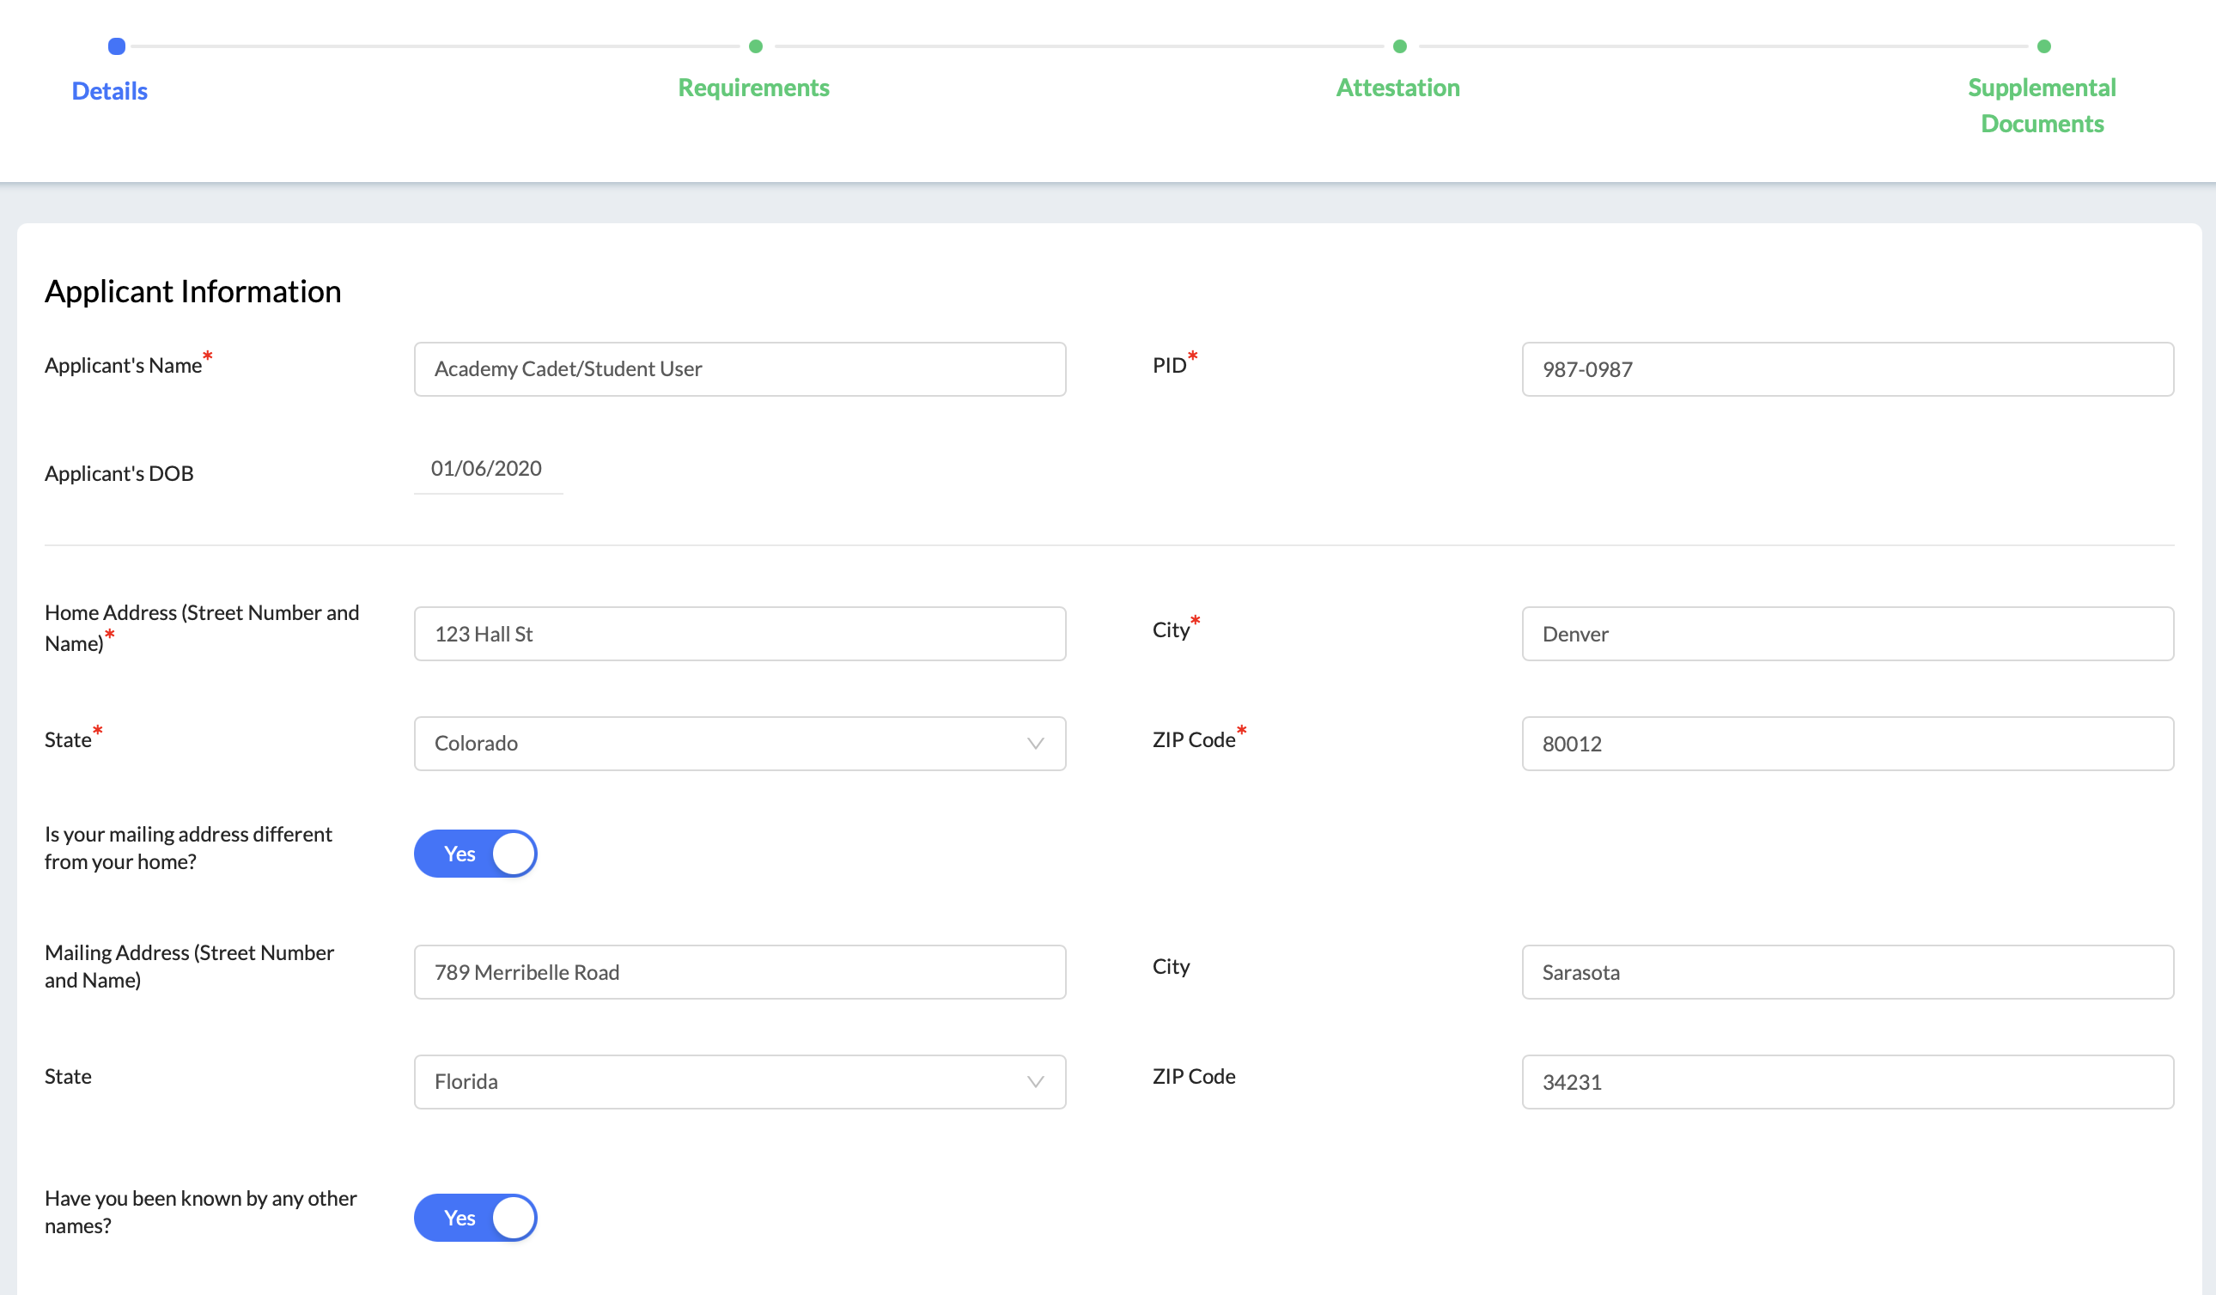
Form 1 – Basic Certification
Cadet Student Experience

Slide 43
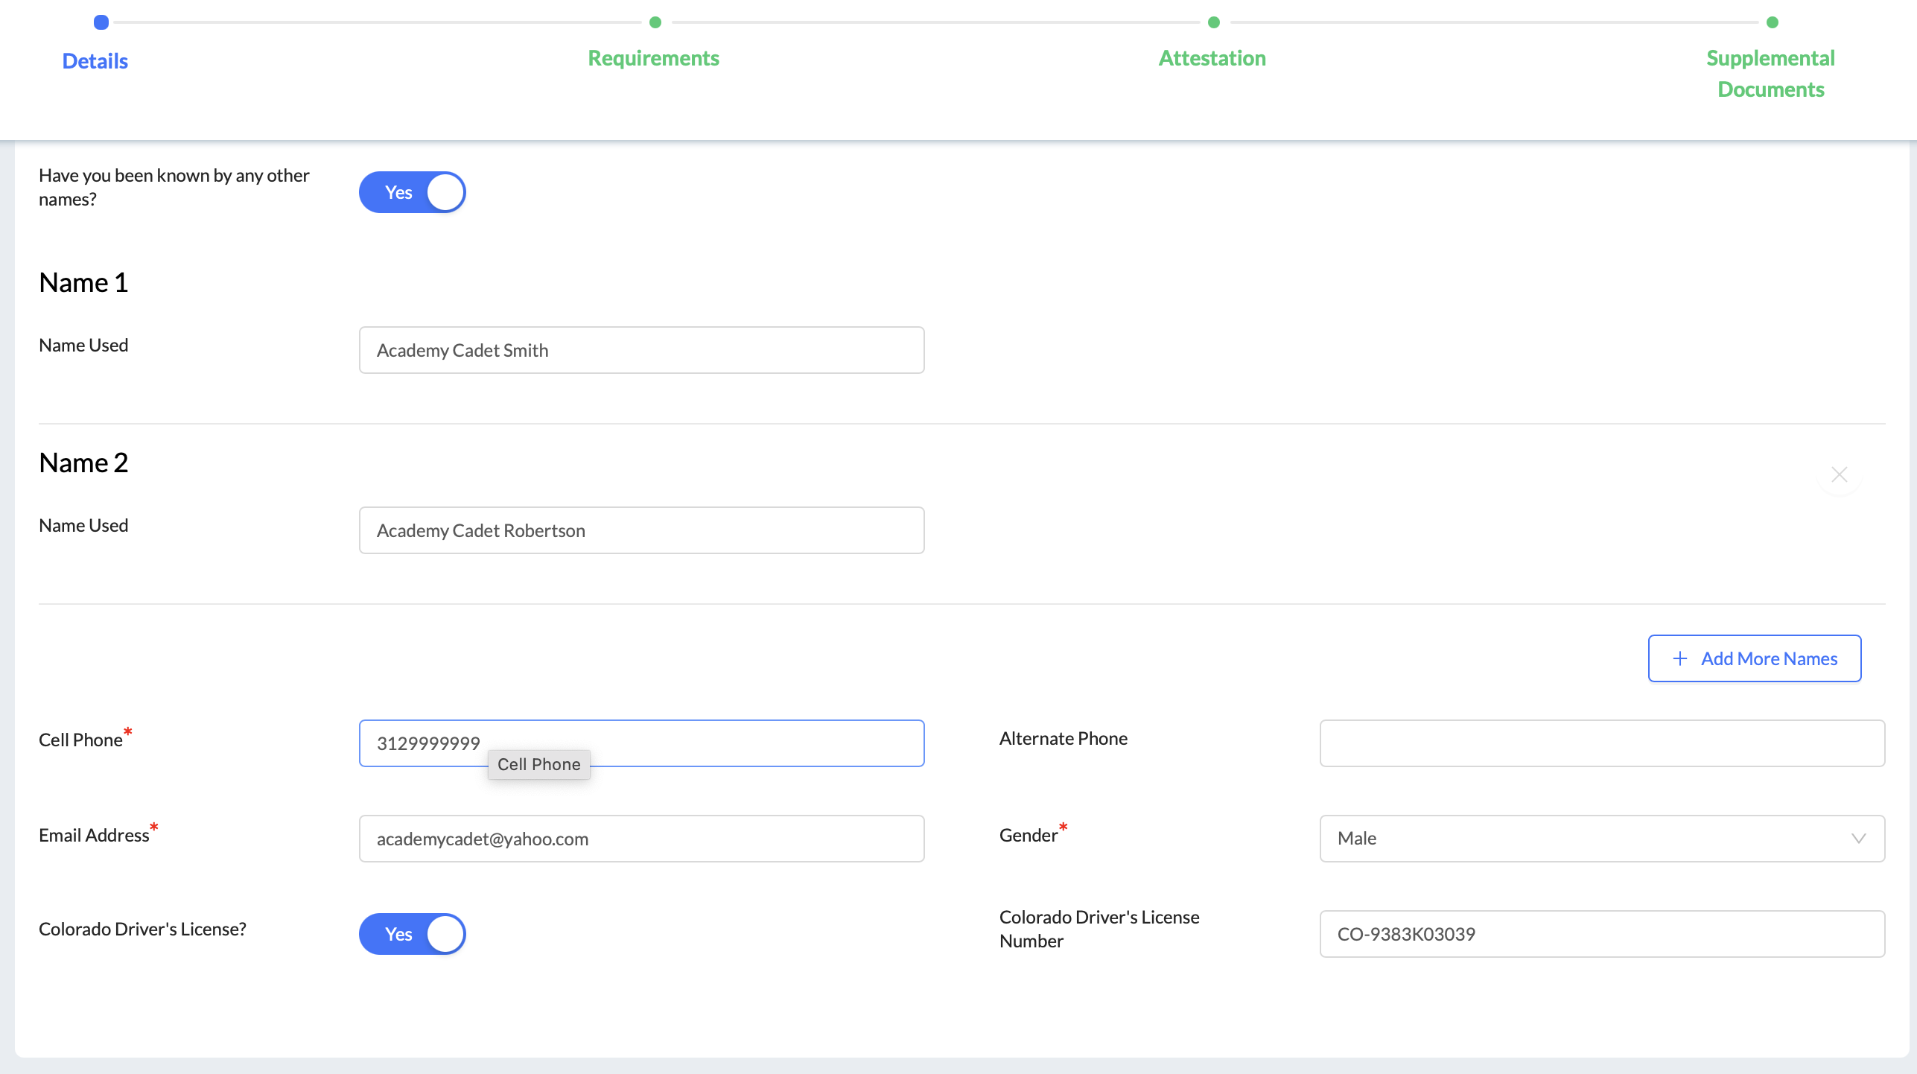
Form 1 – Basic Certification
Cadet Student Experience

Slide 44
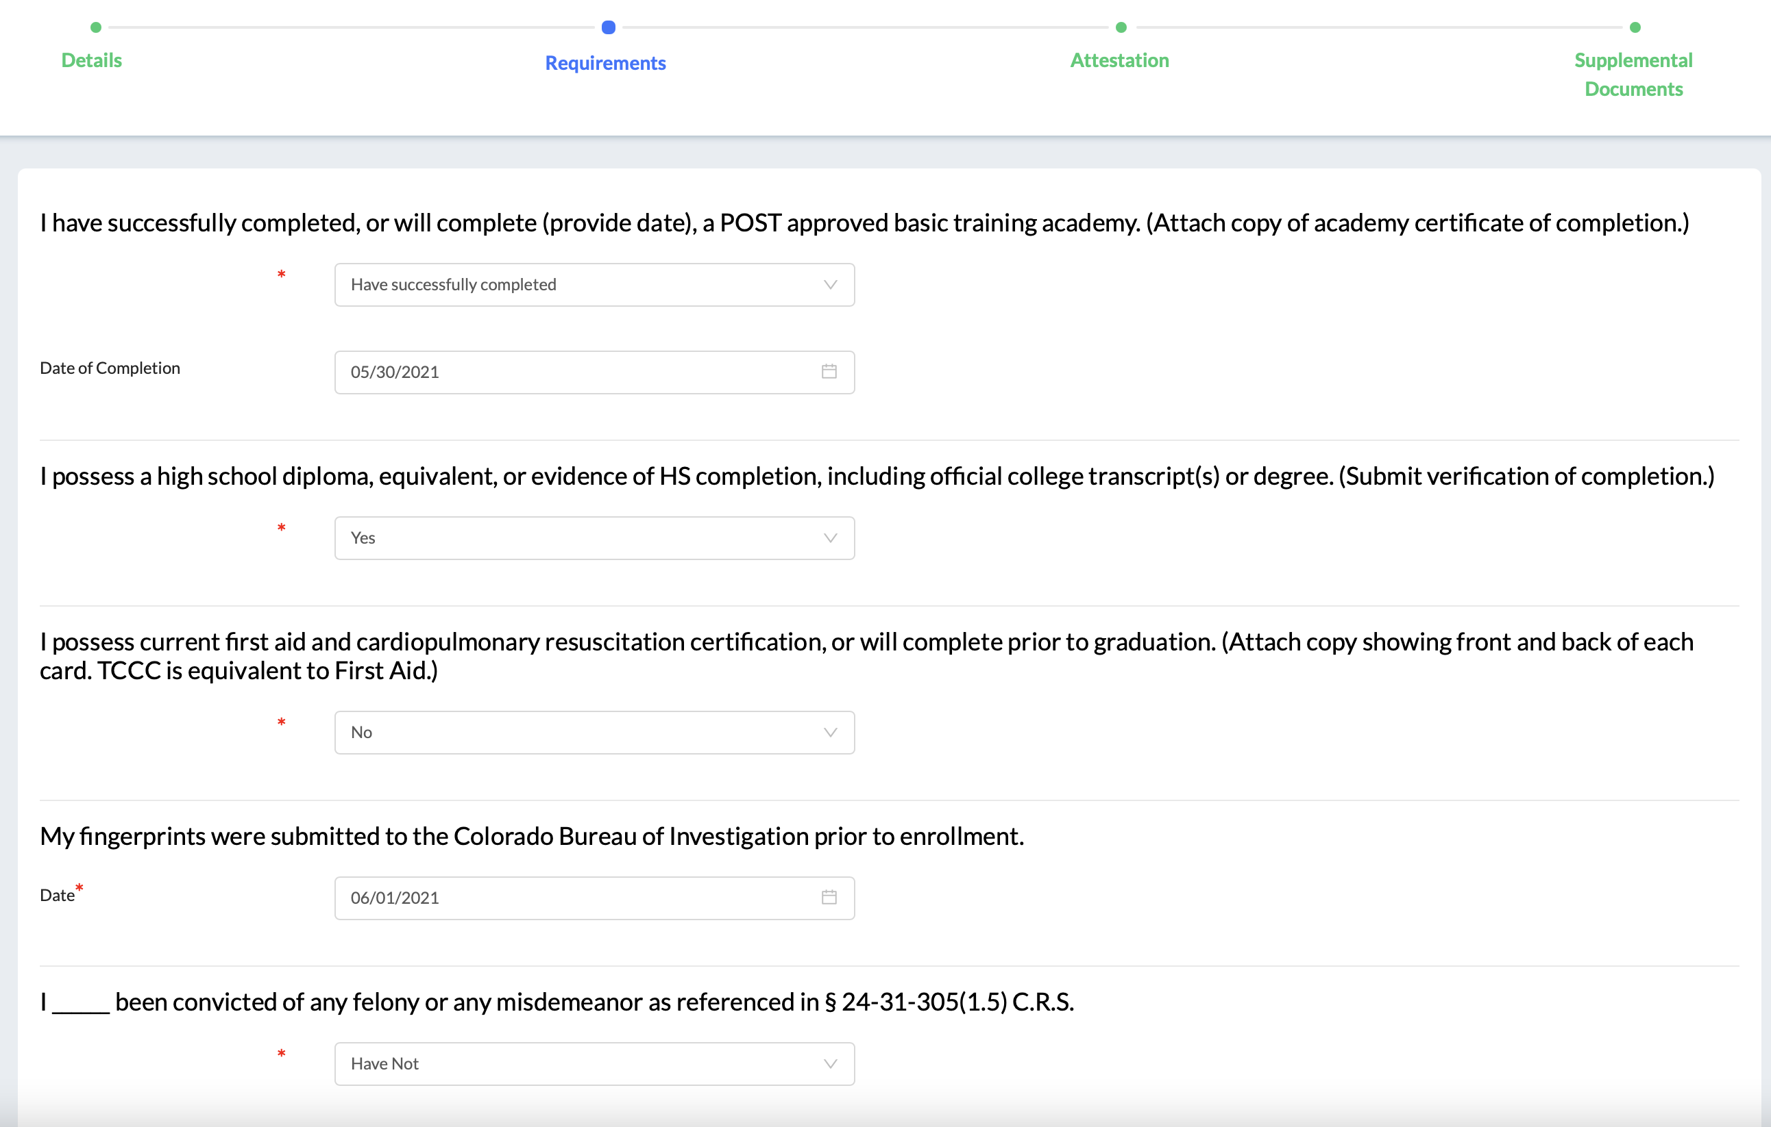
Form 1 – Basic Certification
Cadet Student Experience

Slide 45
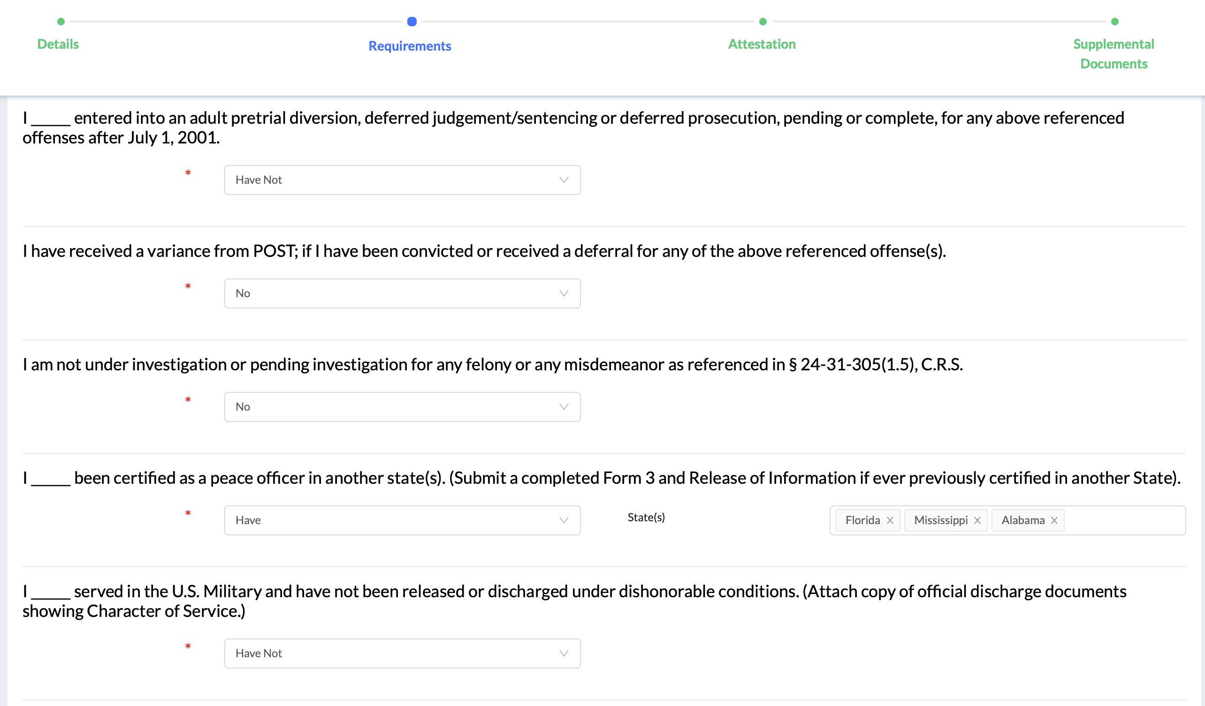
Form 1 – Basic Certification
Cadet Student Experience

Slide 46
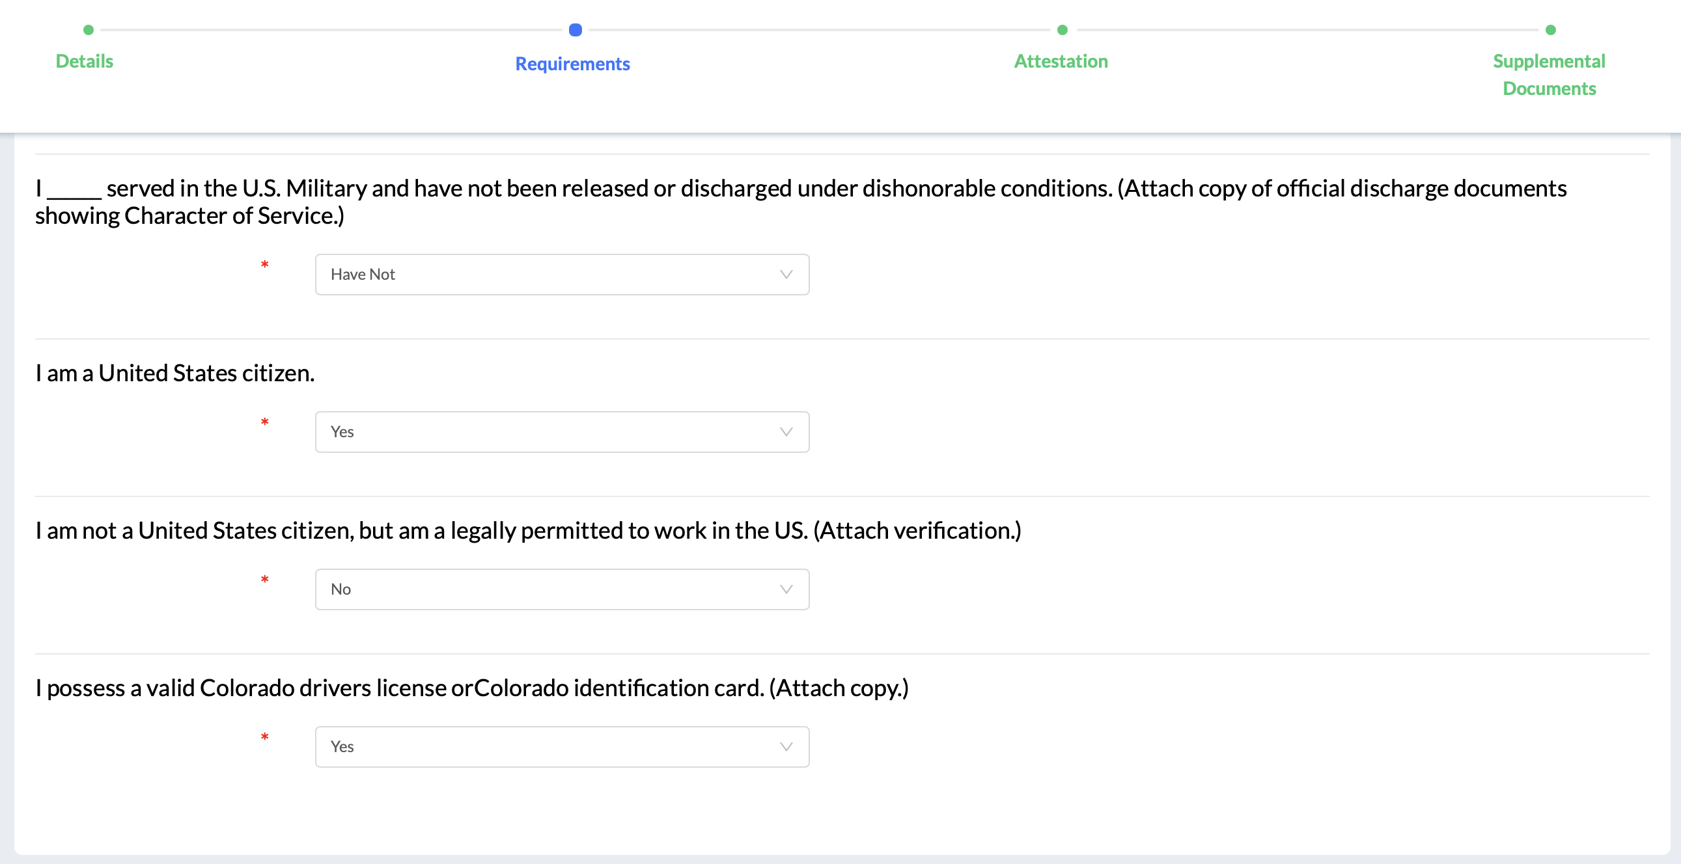
Form 1 – Basic Certification
Cadet Student Experience

Slide 47
Form 1 – Basic Certification
Cadet Student Experience

Slide 48
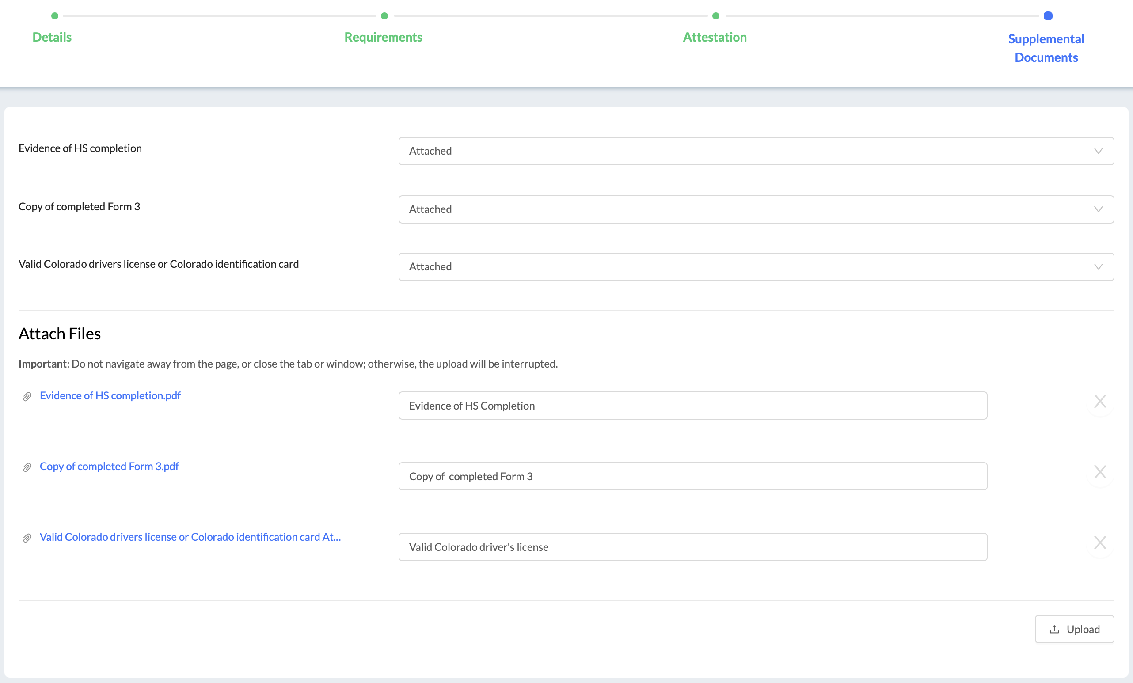
Form 1 – Basic Certification
Cadet Student Experience

Slide 49
Cadet Forms: Form 11E – Enrollment Advisory

Slide 50
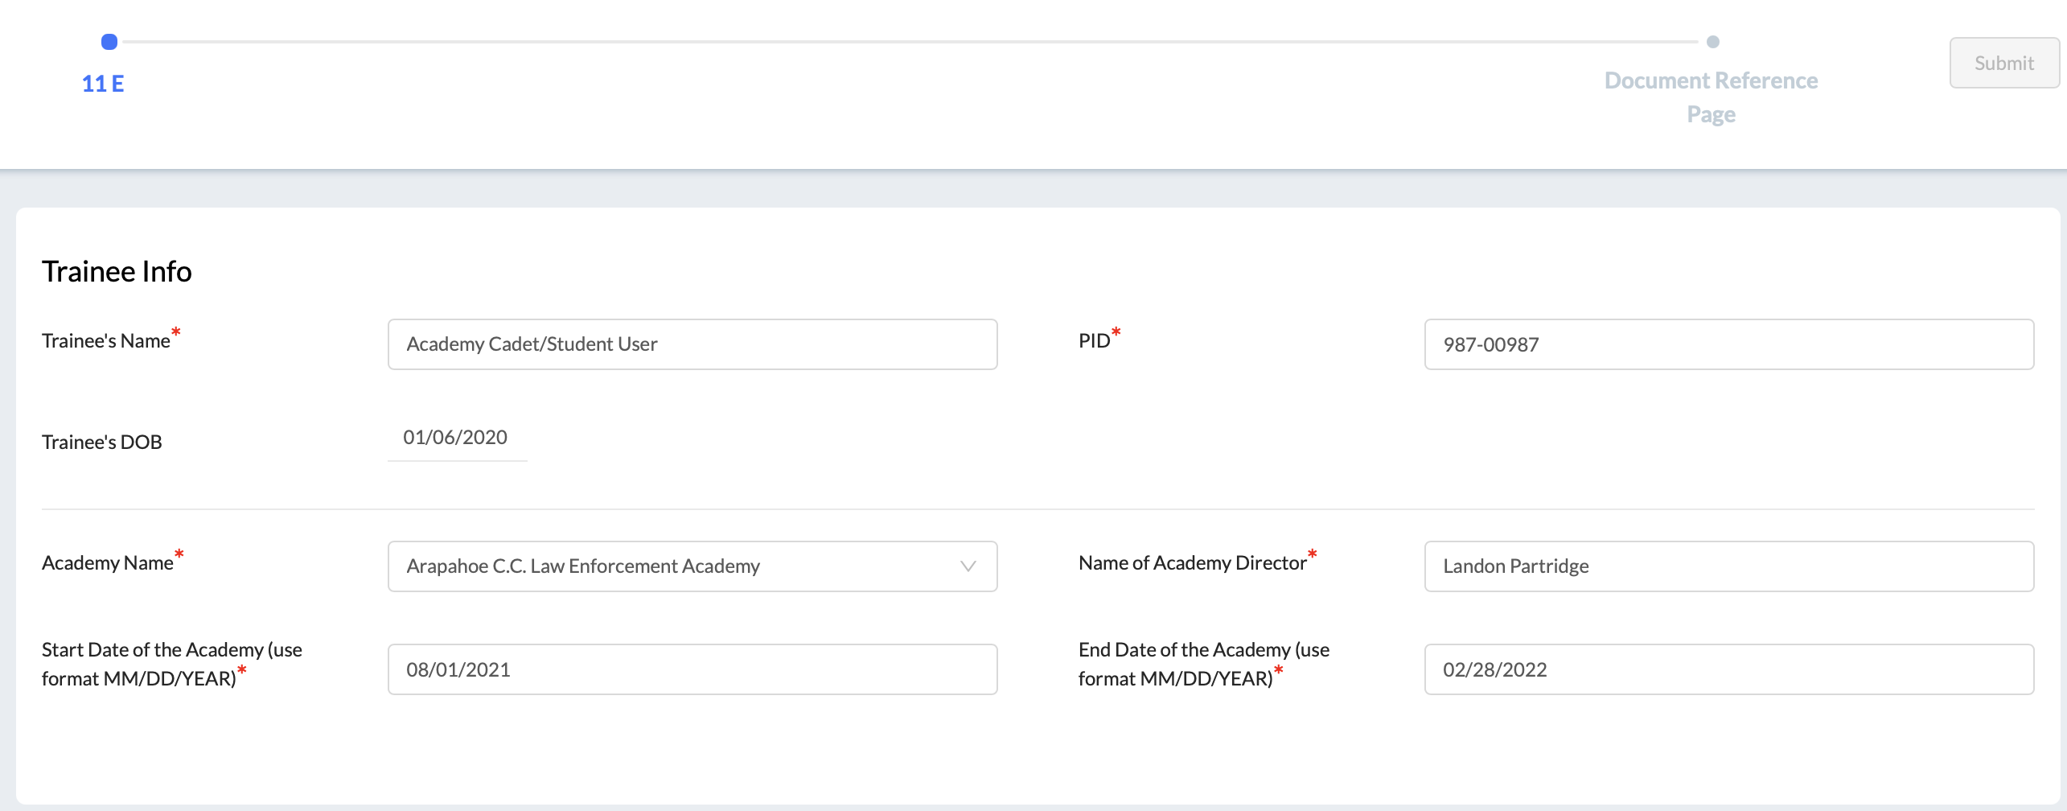
Form 11E – Enrollment Advisory
Cadet Student Experience

Slide 51
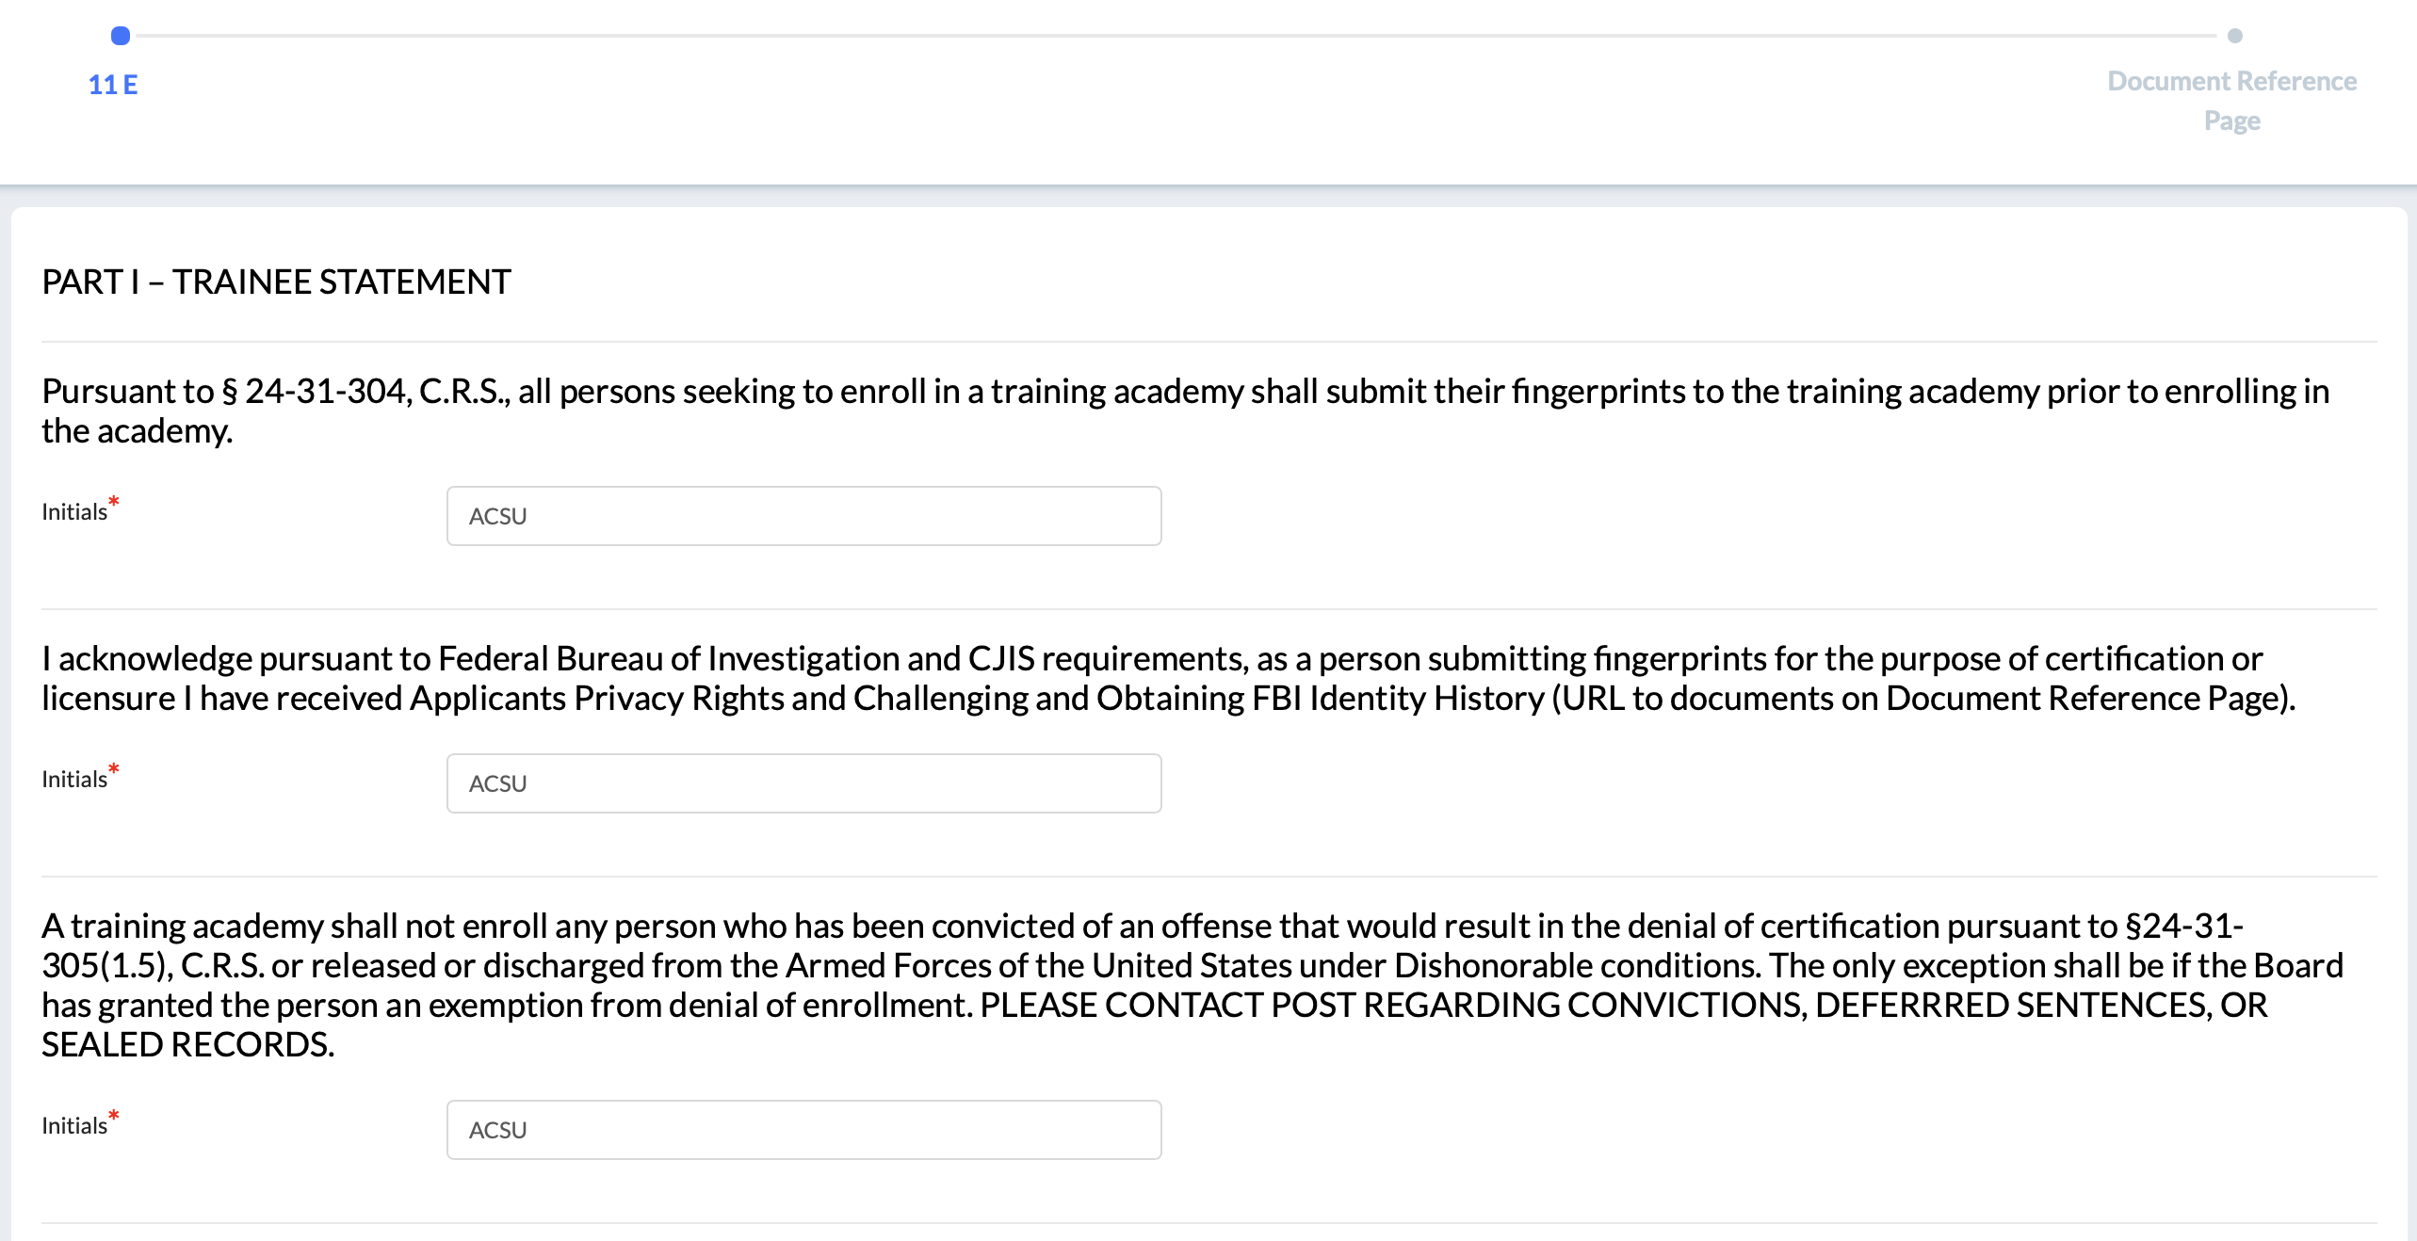
Form 11E – Enrollment Advisory
Cadet Student Experience

Slide 52
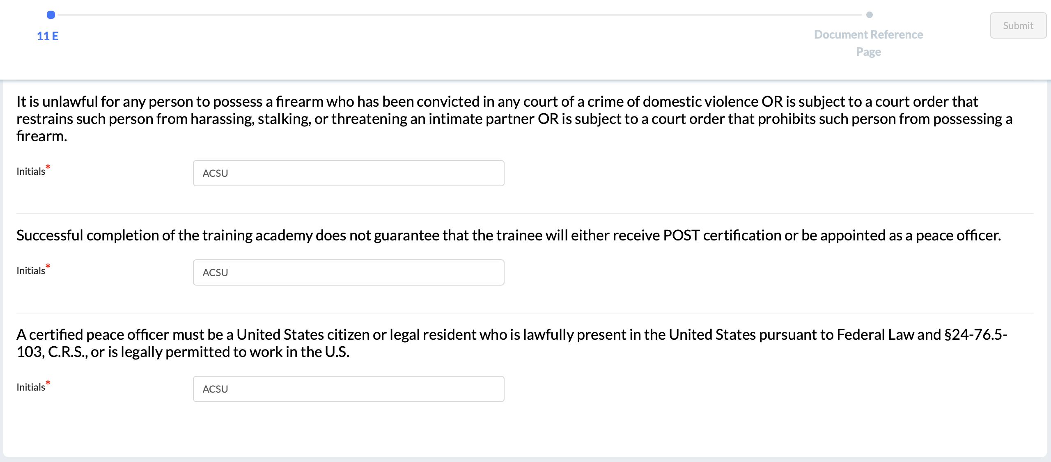
Form 11E – Enrollment Advisory
Cadet Student Experience

Slide 53
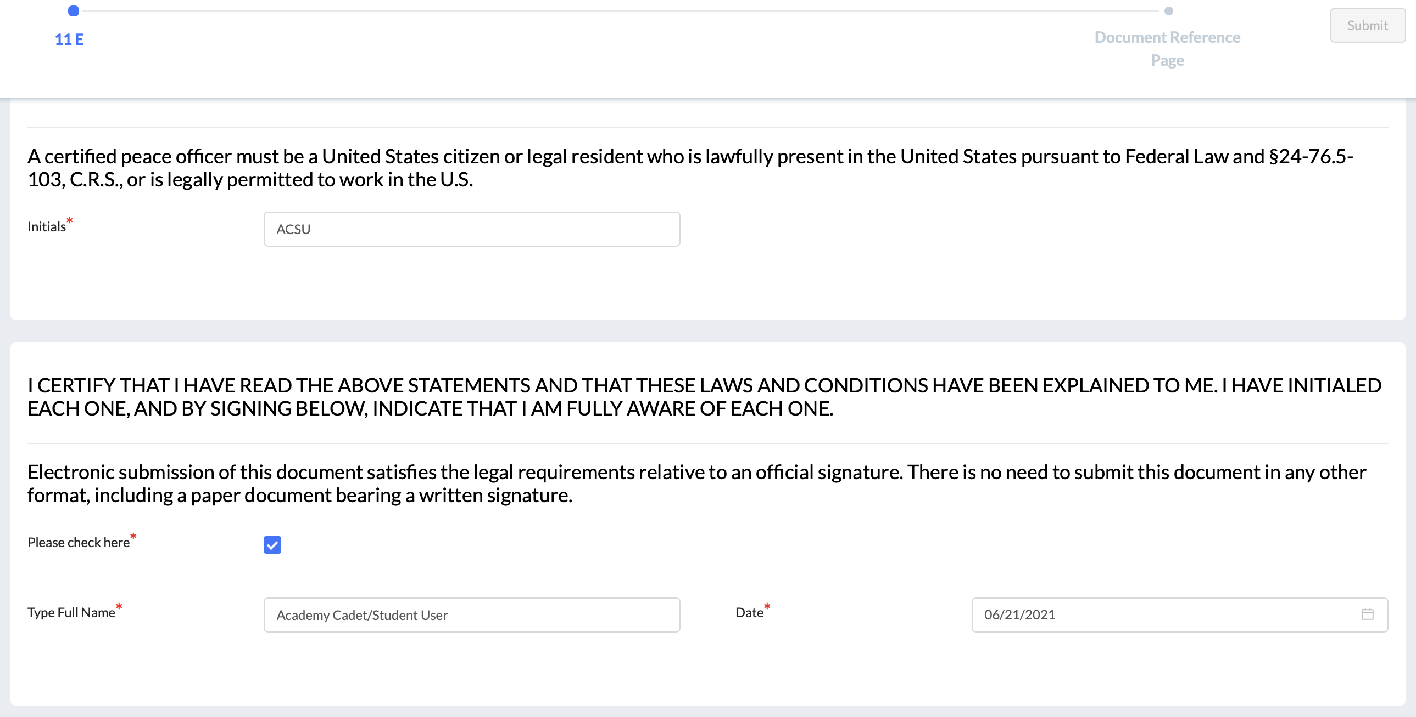
Form 11E – Enrollment Advisory
Cadet Student Experience

Slide 54
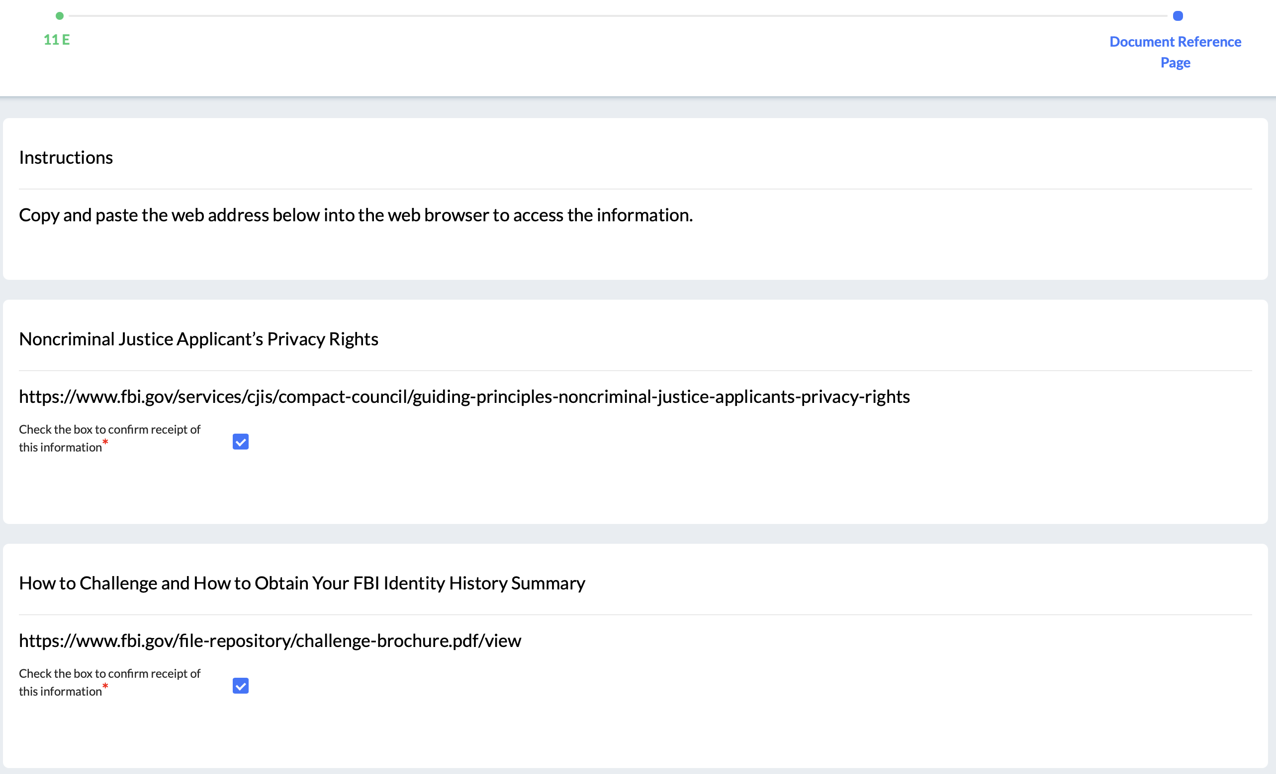
Form 11E – Enrollment Advisory
Cadet Student Experience

Slide 55
Thank you!

