Slide 1

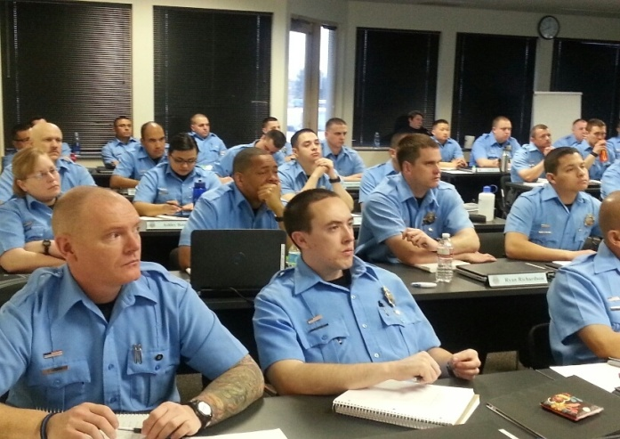
Denver Police
& the Deaf & HH Communites
Denver Office of Sign Language Services
Presenters:
Lorrie A. Kosinski, Cathy Noble-Hornsby

Slide 2
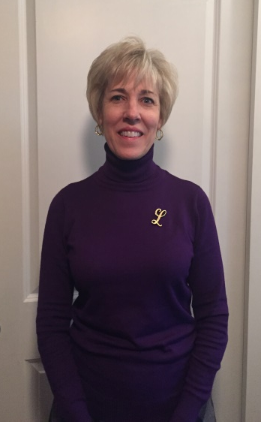
Lorrie A. Kosinski
Director/Sign Language Interpreter
Office of Sign Language Services & Resources
City/County of Denver
201 W. Colfax Ave.
Department 1102
Denver, CO 80202
(720) 913-8487
(303) 880-3208 cell
Lorrie.Kosinski@denvergov.org

Slide 3
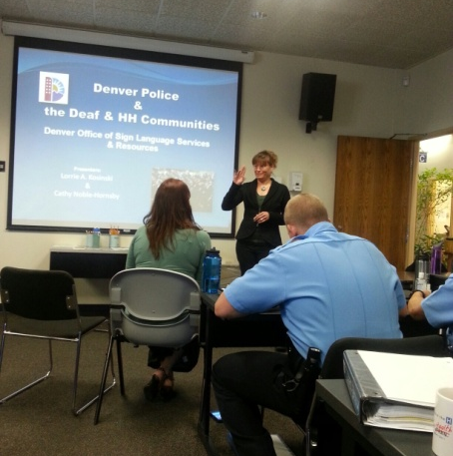
Cathy Noble-Hornsby
Consultant/ Trainer/
Community Advocate
c.noblehornsby@gmail.com
720.210.5571
720.771.4235 Text

Slide 4
Training Agenda
Overview of Deaf /Hard of Hearing Communities
Interacting with Deaf People
Communication Options
Sign Language Interpreter Information
Basic Signs, Gestures & ABCs
T/F Test Throughout
How ALL of this Relates to You

Slide 5
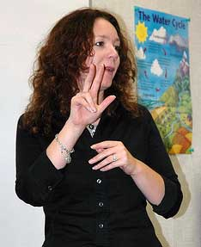
Working with an Interpreter
Logistics
Speaking pace
Speak directly to the deaf person

Slide 6
Who has had a deaf family member, neighbor, co-worker, friend? Who knows some sign language?

Slide 7



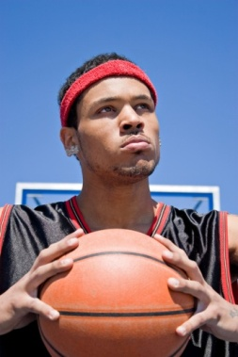





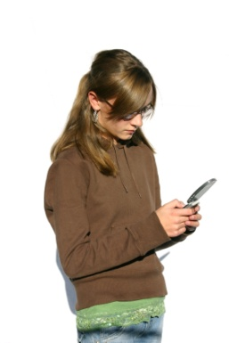

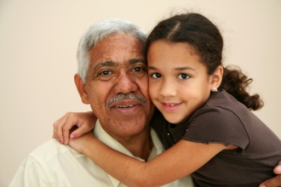



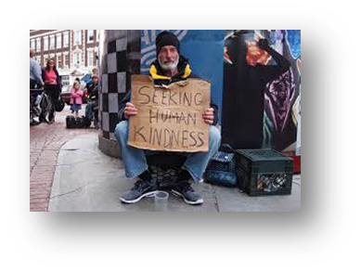
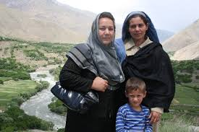
Who is Deaf?

Slide 8
Overview of the Deaf and Hard of Hearing Communities

Slide 9

Deaf/Hard of Hearing Community
Protected class of people-due to their disability (ADA)
  Federally mandated access to all programs and services of local government, including police
  Communication Access: Ramp vs. Interpreter
@ 34,000 deaf & hard of hearing people in Colorado
@19,000 in Denver metro area

Slide 10
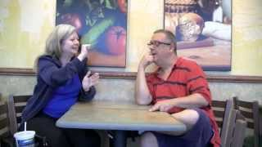
Deaf:
Moderate-profound hearing loss
Associates with the Deaf community & norms
    Use of Tactile Methods/Pointing
    Facial Expressions/Body Language/Gestures
Generally communicates using American Sign Language
Outdated terms: Deaf-mute, Deaf & Dumb, hearing impaired

Slide 11
True or False?
Deaf people see better than hearing people because the loss of one sense makes the other senses stronger.

Slide 12

Linguistic/Cultural Genre of the Deaf
Community
Taking information in visually
Monolingual, bilingual, oral, manual
Age/onset of deafness, degree of hearing loss
Experience in dealing with hearing people

Slide 13
True or False?
Sign language is a universal language.

Slide 14

American Sign Language (ASL):
Native language for majority of Deaf people in the United States
  Different sign languages for different countries
Visual/spatial language with structural & grammatical rules that differ from the English language
  Concepts relayed
  Has dialects
  Not universal
Recognized in CO as a foreign language

Slide 15
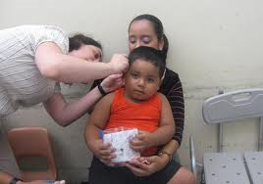
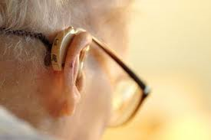
Hard of Hearing:
Mild to moderate hearing loss
Does not necessarily associate with the Deaf community & its norms
With use of a hearing aid, may be able to function fairly comfortably in a hearing world

Slide 16
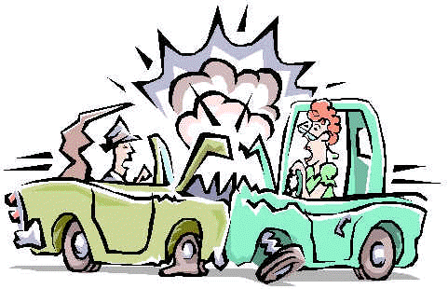
Role Play
DENVER DEAF POLICE:
Traffic Accident

Slide 17


Role Play
Discussion

Slide 18
Interacting with Deaf & Hard of Hearing People

Slide 19
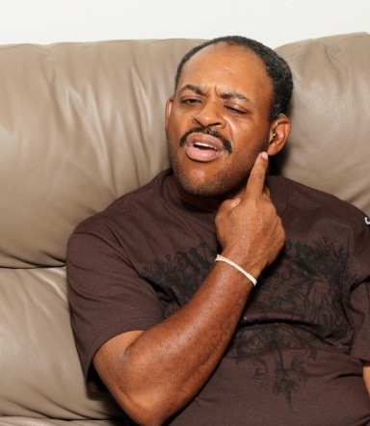
Recognizing Deafness
Person shakes head & points to ears
Person gestures indicating paper and pen for written communication
Moves hands in a repeated pattern, trying to communicate in sign language
Appears very alert, watches faces intently but may not respond to sounds or language
Reacts to environmental noises (siren, alarm, loud noise) but may not understand speech

Slide 20
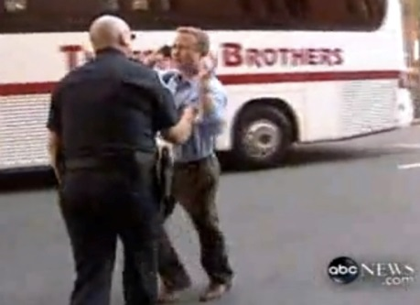
Attention Getting Strategies
Walk around in front
Wave your hand, or tap on hand, arm or shoulder Do not tap on the person’s back
Stomp on floor, tap on table, flash overhead light
Adjust flashlight to assist with communication
  process.

Slide 21
True or False?
Deaf people can call Denver Police or Denver 911 directly without the assistance of a family member or friend who can hear.

Slide 22
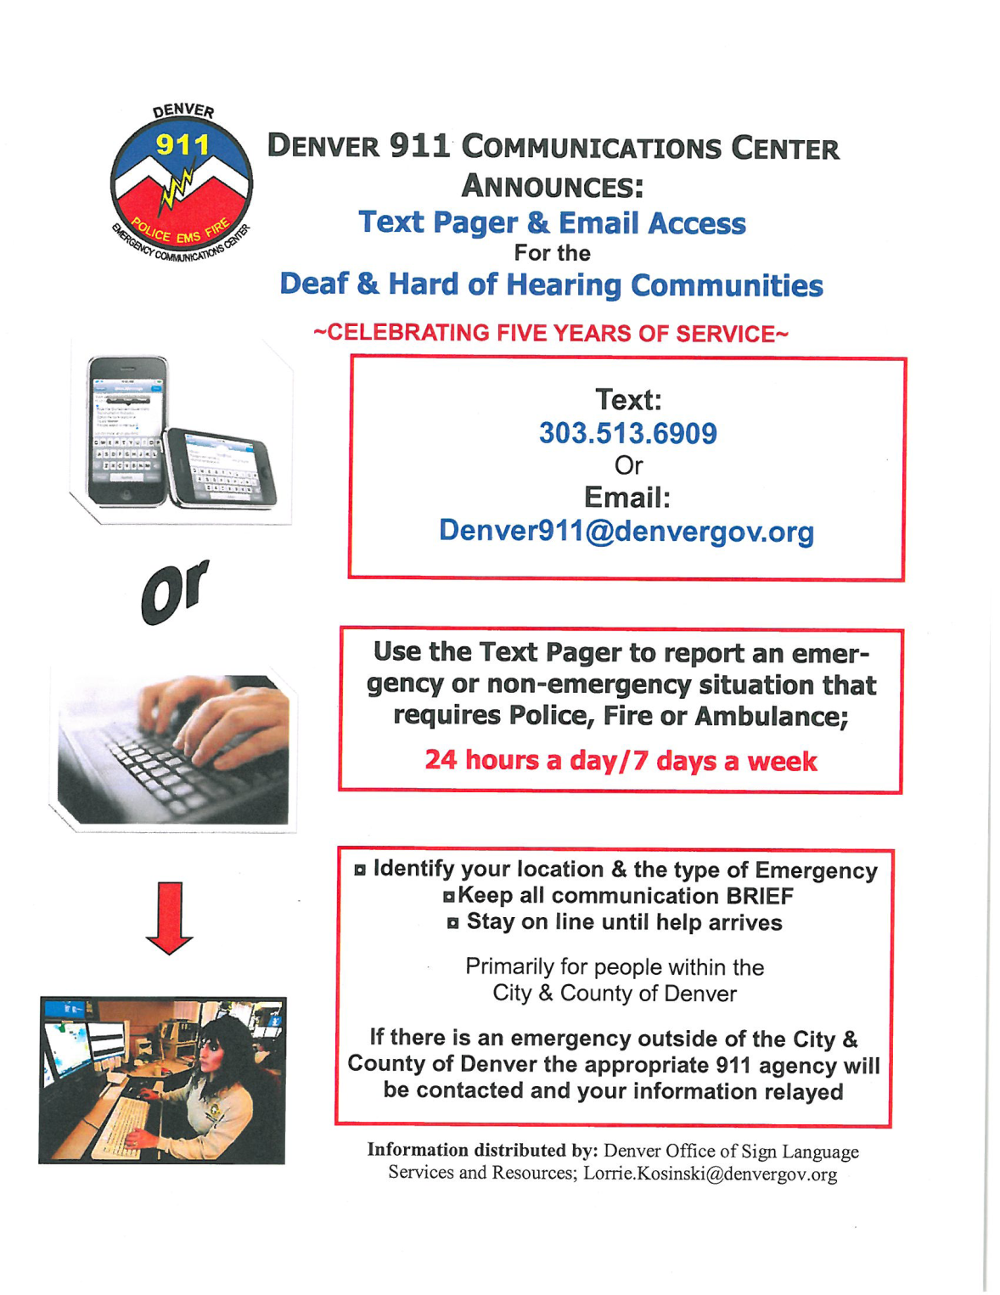
Text/ Email
to
Denver 911

Slide 23
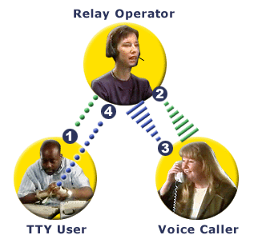

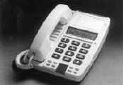
Auxiliary Devices
Used for Contacting Police/ 911
Telephone Device for Deaf (TTY/TDD)
VCO phone/Captioned Phones
Text pagers
Relay Colorado/Internet Relay

Slide 24
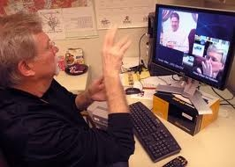
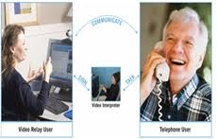
Auxiliary Devices…
Video Phone
Video Relay
Allows for direct communication
Free, 24/7

Slide 25
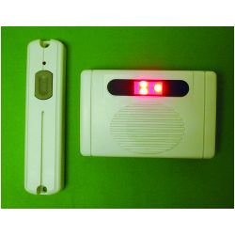
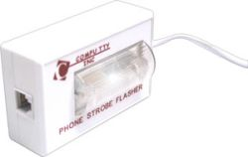
Visual Alarms
Door Bell Alert
Strobe Light/
Phone Ring Alert
Informs a deaf person someone is trying to contact them

Slide 26
Communication Options

Slide 27
Choosing a Communication Option
“The Department must give a deaf or hard of hearing individual the opportunity to request the auxiliary aid or service”
“Primary consideration will be given to the expressed choice of the individual, unless:
  it can be demonstrated that another effective means of communication exists
  or that use of the means chosen would result in undue financial and administrative burdens”
“Police officers are responsible for providing the communication option”
  Communication with People who are Deaf or Hard of Hearing, ADA Guide for Law Enforcement Officers

Slide 28
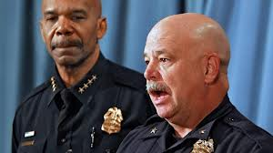
Lip-Reading
Don’t assume a Deaf person can lip-read, or speak
  90% do not lip-read proficiently
  Only 25-35% of speech is visible on the lip
  Not all deaf people can speak
  Communication Tips
  Well lit area
  Face to face
  Don’t obstruct mouth
  Normal speaking pace

Slide 29
True or False?
Deaf people who use sign language generally have difficulty with English, while deaf people who read lips & use their voice generally do not have difficulties with English.

Slide 30
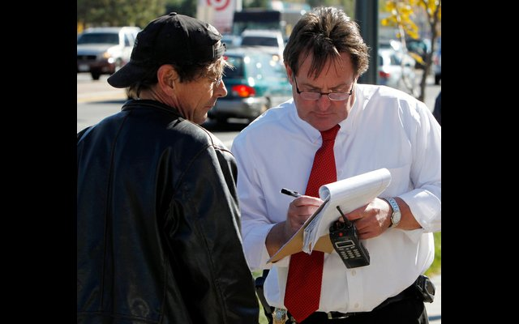
Written Communication
English is a second language for most deaf people
The average deaf person reads & writes English at a 4th grade level
Don’t assume that writing back & forth is “good enough”

Slide 31

Writing Samples…
Hi! Samantha Arellano need tomorrow morning to come to court to press charge to a bussiness man from Art & Craft! He’s names is Bob Jones to places broke window or door! Back door He walk in my House and tell me to get out grab me I very scare of Him!
Ok! Samantha Arellano
Dear Ms. Miller,
Letter sent your got me hello me. Me hello letter sent you for fair. You take dinner me. Saturday OK? Me time 8 p.m. Go house your pick up OK? Quick sent letter me tell no, other time me got Saturday morning, OK? If no get pick up your house time 8 address my:
625 Greenwood Drive
zipper for fly fast 91403
Phone no. my Aunt 784-1940
Up Thumb
Beverly

Slide 32
Advisement of Rights/ Survey Results…
You don’t have to say anything about this case
Anything you say can be used against you
You do not have to testify
If you remain silent, your silence can’t be used against you
If you can’t afford to hire your own lawyer and if there is a possibility that you might receive a jail sentence…
speedy and public trial… appoint a lawyer
Plead obtain case decisions
waive the fee within ten (10) days after you plead not guilty
You also have the right to ask the court to reduce your bail
presumed innocent of the charges
prosecution prove each and every element of the charges beyond a reasonable doubt
You have the right at trial to confront the witnesses against you and to cross-examine these persons. You also have the right to present evidence in your own defense and to subpoena witnesses to testify
You are making a plea knowingly and voluntarily. No one has threatened, coerced or unduly influenced you to make you plea

Slide 33
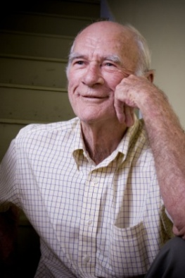
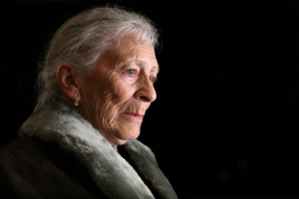
Who is Deaf?

Slide 34
True or False?
An officer who knows sign language can be used as an interpreter to interview a deaf witness, victim or suspect.

Slide 35
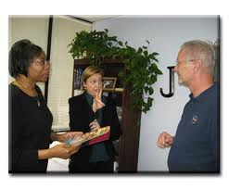
Sign Language Interpreter
Uses sign language to relay information between hearing and deaf parties
Holds national certification
Abides by a Code of Professional Conduct requiring neutrality and confidentiality
  Registry of Interpreters for the Deaf
Holds a Legal Credential Authorization
  Complete at least 100 hours of specialized legal training
  Colorado Statute, CRS 13-90-201 through 13-90-209
Cannot use officers as sign language interpreters—unlike foreign language needs
  Colorado Title Protection Act

Slide 36
When/ How to Obtain a
Sign Language Interpreter

Slide 37
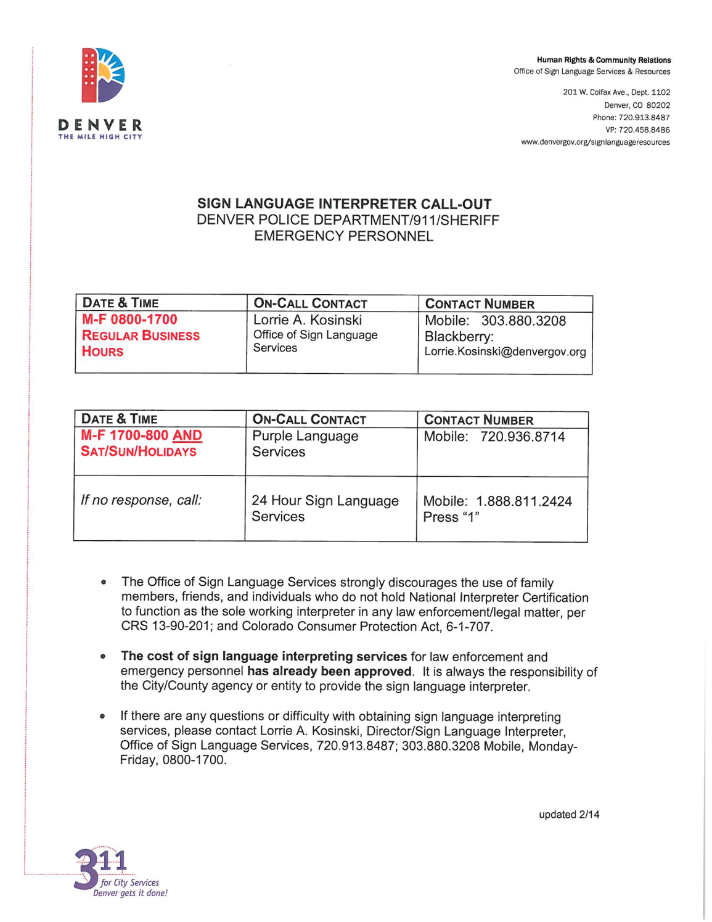
Call Dispatch

Slide 38
True or False?
A deaf person must be provided an interpreter for every interaction with the Police or emergency personnel.

Slide 39
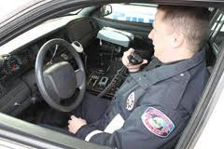
When:
Length, complexity, and deaf person’s communication abilities
  Traffic Stop
  DUI
24/7
How:
Call dispatch
No pre-approval needed
Invoice will be paid through the Office of Sign Language Services

Slide 40
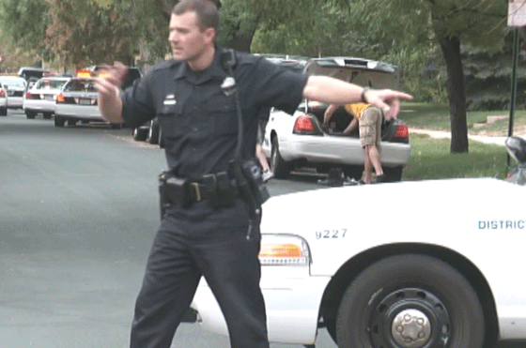
Gestures, ABCs & Signs
    Wait
    Come here
    Over there
    Calm down
    Pointing
    Read this
    Fill this out
    Wrap-Up
Questions/Comments

Slide 41


We’ll look forward to
working with you!
©2015 No reproductions without written permission

